Slide 1
Perinatal and Infant Oral Health
A Practical Guide
Emily Norrix, MPH
Perinatal Oral Health Consultant
Michigan Department of Health and Human Services

Slide 3
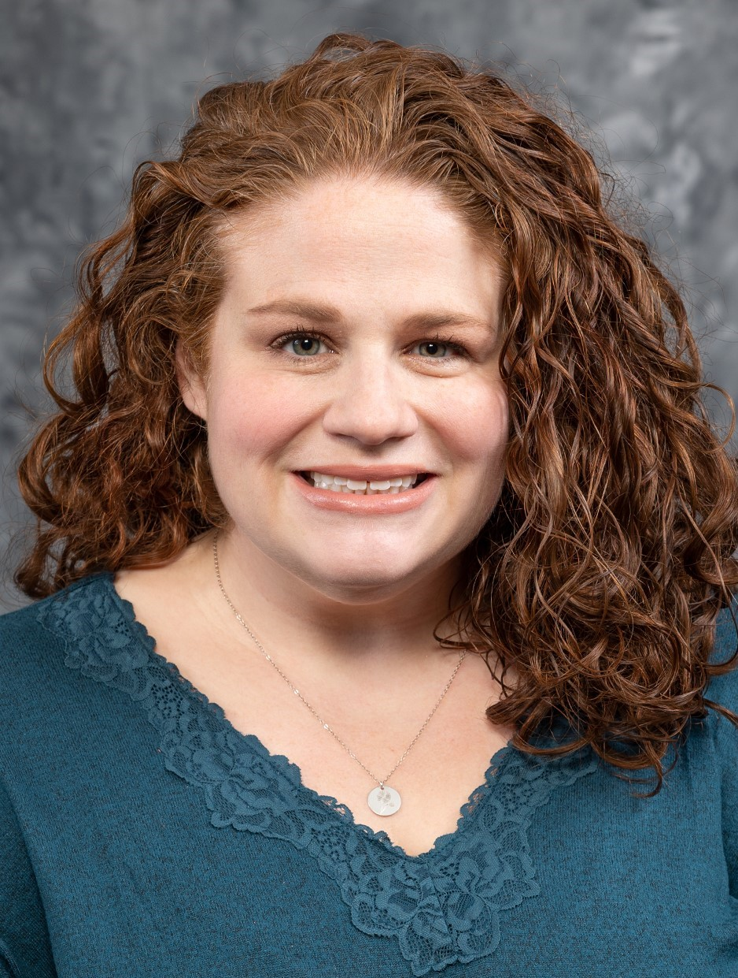
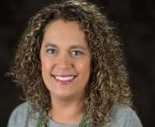
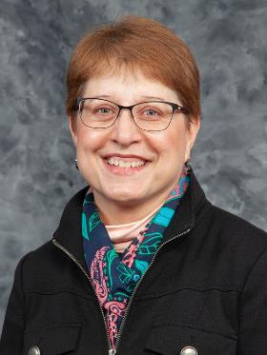

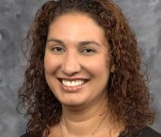
MEET THE TEAM
Emily Norrix Perinatal Oral Health Consultant
Heather Beavers
Early Child Oral Health Specialist
Christine Farrell
Oral Health Program Director
Sandy Sutton
Fluoridation Coordinator
Erin Suddeth
PA161/Mobile Dentistry Consultant

Slide 4
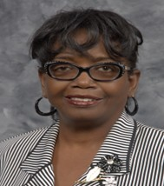

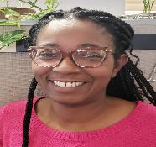
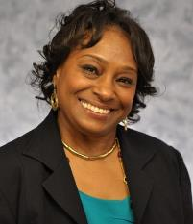
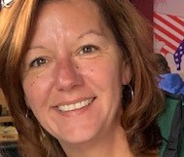
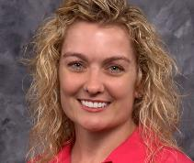
AL LYON
Oral Health Secretary
JAYMEE CLARK
MI Dental Program
EVA WINSTON
Project Assistant
JENNIFER CALKINS
MI Dental Program
PAM MANNING
MI Dental Program
LAURA WRIGHT
DPSCD Oral Health Coordinator
ORAL HEALTH PROGRAM STAFF

Slide 5
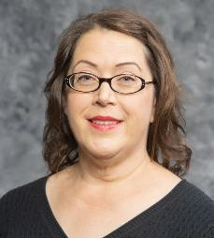
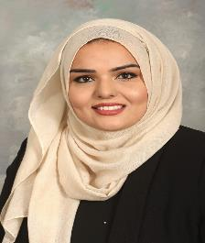
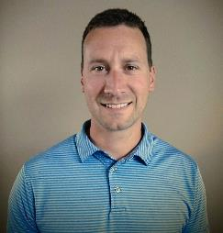
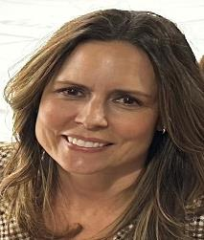
t
MICHELE KAWABE
Oral Health Kindergarten Assessment Consultant
Mona Riaz
Oral Health Workforce Consultant
Kyle Norman
Oral Health and Medicaid Outreach Specialist
ORAL HEALTH PROGRAM STAFF
Andrea Whittaker
School Oral Health Consultant
ALAINA WHITE
Oral Health Epidemiologist

Slide 6

Michigan
Oral Health Program
  Community Water Fluoridation
  School-based Sealant Programs
  Kindergarten Oral Health Assessment
  Age Based Programs
  Workforce Programs
  Perinatal Oral Health
  Surveillance and Evaluation
  Partnership & Collaborations
  Health Systems Interventions
  Oral Health Coalition
  Webpage: www.michigan.gov/oralhealth
Notes:
CWF and SBS programs are the two evidence-based programs.
Function of assessment is Surveillance
Mention surveys such as PRAMS, BRFS, Count Your Smiles YRBS, YTS

Slide 7
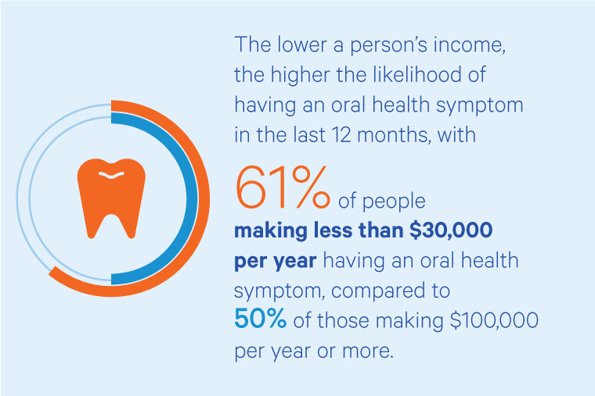
Health Equity
According to CareQuest Institute research, 93% of individuals living in poverty have unmet dental needs, compared with 58% in high-income families.
Oral Health Equity | CareQuest Institute

Slide 8

Oral Health Disparities
Based on data from 2011–2016, for children aged 2 to 5 years, about 33% of Mexican American and 28% of non-Hispanic Black children have had cavities in their primary teeth, compared with 18% of non-Hispanic White children. For children aged 12 to 19, nearly 70% of Mexican American children have had cavities in their permanent teeth, compared with 54% of non-Hispanic White children
Nearly twice as many non-Hispanic Black or Mexican American adults have untreated cavities as non-Hispanic White adults
Disparities in Oral Health | Division of Oral Health | CDC

Slide 9
Setting the Scene- Workforce

Slide 10
Michigan State Oral Health Plan
Assessments Over Time
-Michigan State Oral Health Plan 2020 (2015 data)
HRSA estimates that 862,159 people live in Michigan’s dental HPSAs and that
To remove the dental shortage designations, 121 additional dental professionals would be needed.
-Michigan State Oral Health Plan 2025 (2021 data)
[Regarding dental HPSAs]
HRSA estimates that 1.6 million Michiganders have inadequate access to dental services and that
An additional 400 dentists are needed to serve them.
00

Slide 11
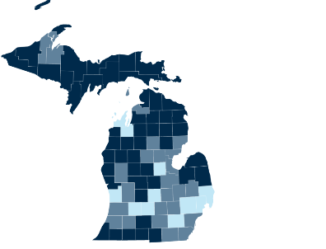

Current Dental HPSAs in MI
47 counties are entirely HPSA
25 counties are partial HPSAs
11 counties are fully served
*there are still underserved individuals within these counties!
Health Professional Shortage Areas, Dental Care, 2023
00
Notes:
6th most number of dental HPSAs in the country

Slide 12
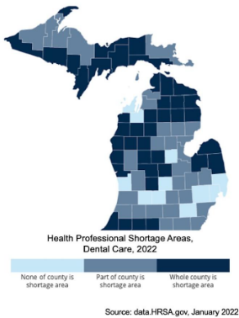
Dental HPSAs 1/22 vs. 5/23
7 counties changed from
Part of county contains dental HPSA
to
Whole county is dental HPSA
Health Professional Shortage Areas, Dental Care, 2023
00

Slide 13

Distribution Issues
Both MI dental schools are in SE MI
  High student debt, business ownership, & production-based pay means they gravitate to highly populated & affluent areas
No dental hygiene program in the Upper Peninsula
Most RDA pathways are 2-year AAS degree for relatively low pay
Most DDS, DHs and DAs go into private practice or DSOs; most don’t learn of public health options
00

Slide 14

COVID Impact on OH Workforce
12.6%
12.1%
10.5%
Decrease in dentists
Decrease in RDH workforce
Decrease in DA Workforce
[By 2021] Employed dentists are within 2.0% of pre-pandemic levels. However, increased burnout and compassion fatigue are affecting retention of dentists in the workforce
6.5% had returned to work by 2021. 90% of hiring dentists report significant challenges in filling staffing vacancies.
In 2021, employment numbers were within 1.2% of pre-pandemic numbers; however, dentists reported difficulty finding and hiring dental assistants.
00
Source: AIDPH-Workforce-2022.pdf
Notes:
RDH: Cited reasons for not returning include lack of childcare, work/life balance, decreased satisfaction with career choice, vaccination mandates, and low compensation

Slide 15
Perinatal Oral Health In Michigan
A Practical Guide

Slide 16
Tell us your stories!
What are you experiencing in trying to get pregnant people into dental care?

Slide 17
Why is it important for pregnant people to see the dentist?
Studies show that periodontal disease (gum disease) may be a contributing factor for preterm birth.
You can pass the germs that cause cavities to your infant child.
There may be pregnancy related oral health issues that need to be addressed.
Half of all Births in Michigan are covered by Medicaid. There is a comprehensive Medicaid Dental Benefit for all Medicaid beneficiaries. This presents an opportunity to receive needed care.
By addressing the oral health of mom, we can help the oral health of the future baby at the same time.

Slide 18
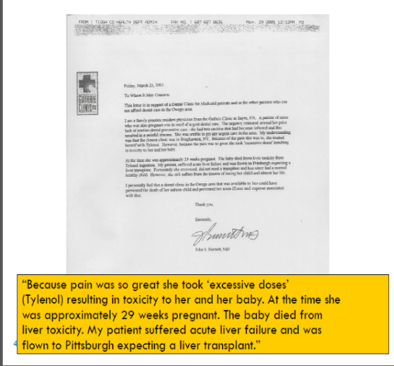
This is not a drug over-dose story or an accidental death story, but rather a perinatal oral health story

Slide 19
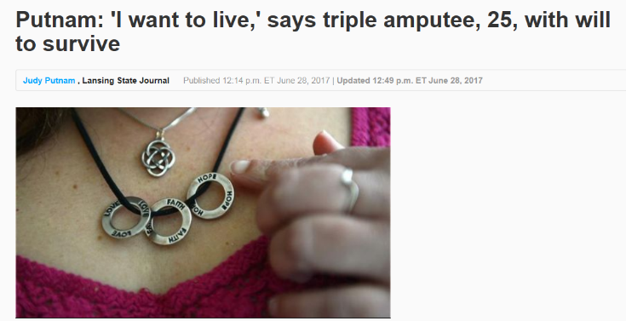

A Michigan Issue

Slide 20
A Little History
The Perinatal Oral Health Initiative was started as part of a national response to reports of fetal demise related to oral health conditions
We work collaboratively with partners across the state to educate patients and providers, increase access to care, and develop creative models to improve oral health for pregnant people.
Michigan joined other states in creating guidelines and starting educational initiatives for both medical and dental providers as well other entities.

Slide 21
Michigan Data Landscape
What does the data tell us?

Slide 22
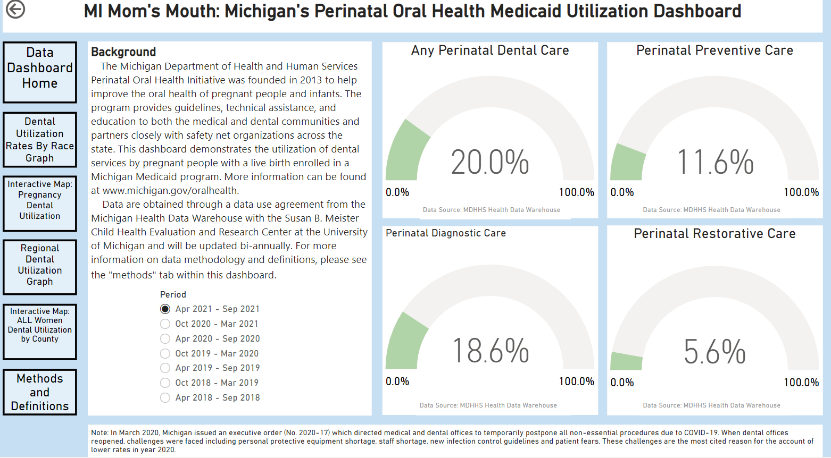

Slide 23
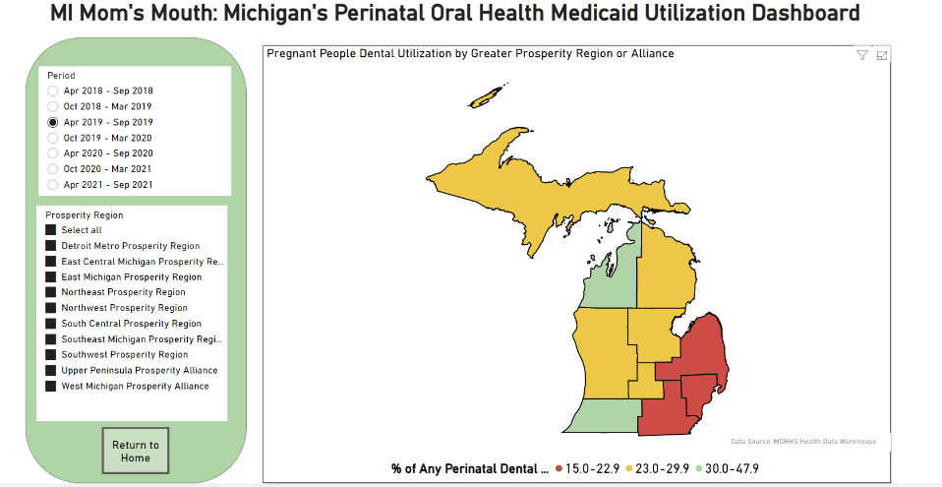

Slide 24
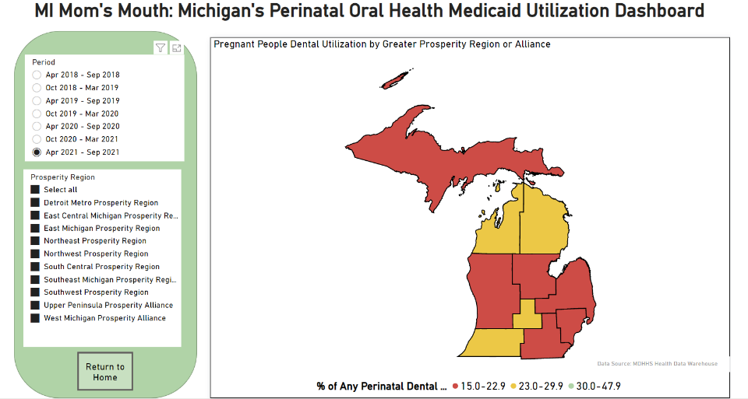

Slide 25
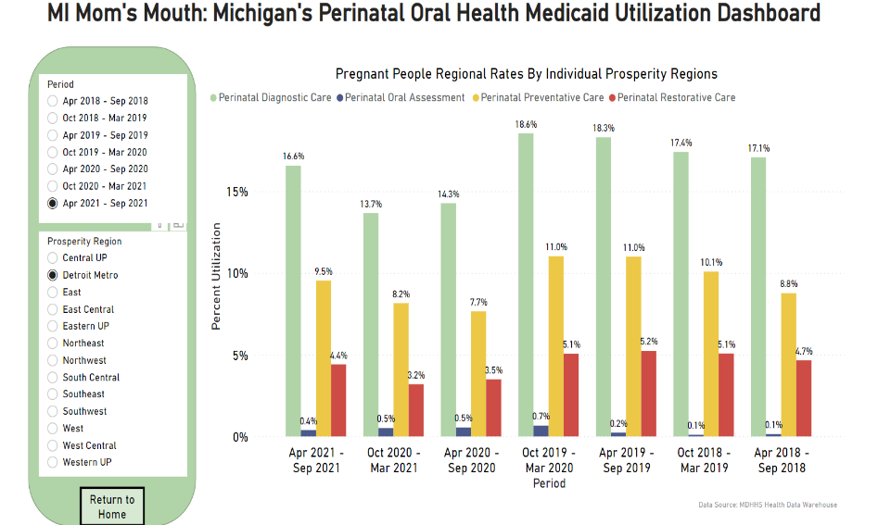

Slide 26
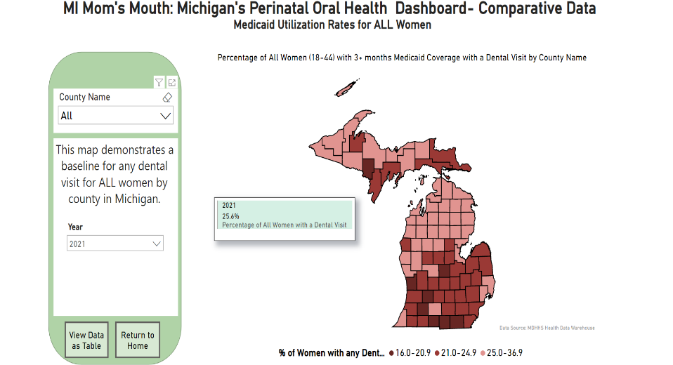

Slide 27
Data: A Summary of MI Medicaid Utilization
As of 2022 only 20% of pregnant people on Medicaid had any contact with the dental system during their pregnancy.
Only 5% had restorative (a filling etc.) care.
Rates vary by race/ethnicity and geographic region.
  In 2022 the Detroit Metro Region is at 17% for any dental care, and 4% for restorative.
  In 2022 the Northwest Region is at about 29% for any dental care and 11% for restorative
  Non-Hispanic white populations have higher utilization than other groups
Covid caused a reduction in already low rates. While slowing rising they have not reach pre pandemic levels.

Slide 28
Expansion of Michigan Medicaid Over 21 Adult Dental Benefits
NOW 100% reimbursement rate – fees had not been increased in over 30 yrs

Slide 29
Michigan Dental Medicaid Benefits
Nearly half of all births in Michigan are covered by Medicaid.
Michigan has a comprehensive dental benefit for beneficiaries; in fact, the reimbursement rate was just dramatically increased (2023) along with additional services like periodontal coverage, crowns, and root canals.
Coverage for pregnant people has increased to a year postpartum as part of Healthy Moms, Healthy Babies. (2022)
Pregnancy is an opportune time to try and address oral health needs- it’s possible that due to their pregnancy someone may now have dental insurance.
It is an extreme challenge to try and find dentists who accept Medicaid insurance. ( FQHC’s, community clinics etc.)

Slide 30
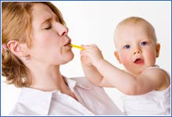
Caries Transmission
We Are NOT born with cavity causing bacteria (Strep mutans); We acquire it from our environment.
Transmission happens even before children develop teeth.
Transmitted through kisses, pacifiers, bottles, spoons, forks, etc.
Cariogenic bacteria (strep mutans) can be transmitted from mother (OR sometimes caregiver) to infant child.

Slide 31
Caries Transmission
Early transmission of microbes is a significant risk factor for future caries experience.
Mothers with higher salivary levels of Streptococci mutans are more likely to infect their infants early in life.
Controlling these levels through preventive care for the mother has shown a reduction in the transmission.
Presents an opportunity for education and motivation

Slide 32
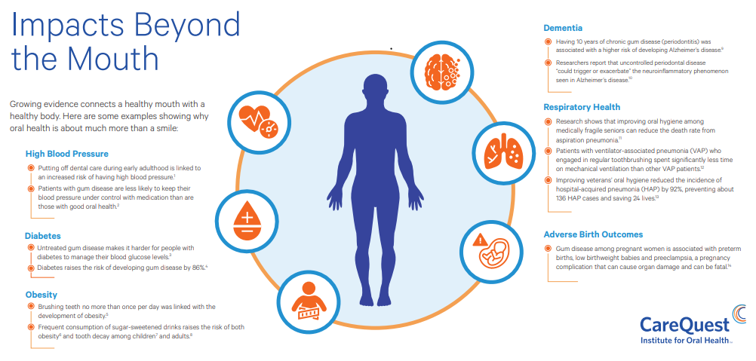
Healthy Mouth = Healthy Body

Slide 33
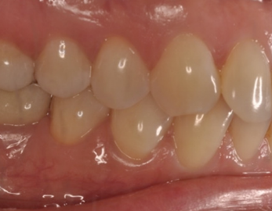
Common Oral Health Conditions During Pregnancy
Pregnancy Gingivitis
Pyogenic Granuloma
Tooth Mobility
Tooth Erosion
Caries (Cavities)

Slide 34
Barriers to Receiving Care
Dental Community
  Misconception as unsafe during pregnancy; unfounded concerns over safety and litigation
  There have been NO valid lawsuits against dentists regarding dental care and subsequent pregnancy complications in Michigan.
  Consensus: If a woman has pregnancy complications due to the refusal of her dentist to treat oral health conditions, that dentists is MUCH more liable than if he/she did not treat!

Slide 35
Barriers to Receiving Care
Dental Community
  Lack of dentists who accept Medicaid
  Dentists may be siloed in their community with a lack of interprofessional practice.
  Unsure of pharmaceutical considerations
  Unwillingness of dentists to treat pregnant people; many were taught to defer treatment.
    Originally: NO dental treatment during pregnancy….
    Then: Only in 2nd trimester and only if urgent……
    Then: All dental care in 2nd trimester……
    Current National Consensus: Treat ASAP

Slide 36

Barriers to Receiving Care
Patient Barriers
People may not understand why oral health care is important
Oral Health may be perceived as a luxury
Not always a standard of prenatal/ pregnancy care
Fear
Socioeconomic Barriers etc
Under the age of 18, pregnant, with no guardian present

Slide 37
Strategies to Integrate and Overcome Barriers
Know your local dental community
Who takes Medicaid? (MCDC, FQHC’s, other local community clinics, etc)
Are they accepting new patients? Do they have a waiting list? How long?
Will they see pregnant patients? Any trimester?
*Does the dentist require a formal referral and/or signoff from an OBGYN?*

Slide 38

Strategies to Integrate and Overcome Barriers
Ask the right questions!
DO NOT only ask “ Do you have a dentist/ dental home?”
If a person saw a dentist at an office 12 years ago, they still may say yes……
Instead:
When was the last time you went to the dentist?
Are they local?
Could you call them tomorrow and make an appointment if you needed to?

Slide 39
Strategies to Integrate and Overcome Barriers
Use this as an opportunity to discuss other important topics
For example:
Smoking cessation and reducing oral cancer risk
HPV vaccination
Nutrition
Obesity

Slide 40
Barriers to Care: MythBUSTERS!
“I can’t get x rays while pregnant.”
“Lose a tooth for every pregnancy.”
“Baby sucked the calcium out of my teeth.”

Slide 41
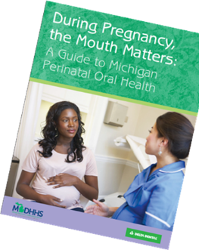
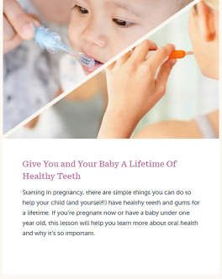
Resources
Michigan.gov/oralhealth
  Guidelines
  Pregnancy and Opioid Guidelines for dental professionals
  Free materials in multiple languages
  Resources and studies

Slide 42
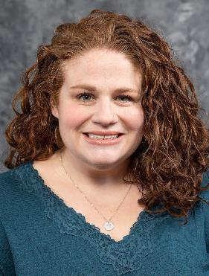
Thank you!
Emily Norrix, MPH
Perinatal Oral Health Consultant
norrixe@michigan.gov

Slide 43
References
Oral Health Care During Pregnancy Expert Workgroup National Maternal and Child Oral Health Resource Center. Oral Health Care During Pregnancy: A National Consensus. 2012; https://www.mchoralhealth.org/PDFs/OralHealthPregnancyConsensus.pdf.
Committee Opinion No. 569: Oral Health Care During pregnancy and Through the Lifespan. Obstet Gynecol. 2013;122(2 Pt 1):417-422
Michigan Health & Human Services. Oral Health Dashboard: MI Mom's Mouth - Michigan Medicaid Perinatal Oral Health Care Utilization. 2022. https://www.michigan.gov/mdhhs/keepmi-healthy/communicablediseases/epidemiology/chronicepi/oral-health-epidemiology/oralhealth-dashboard-michigan-medicaid-perinatal-oral-health-care-utilization-2018-2021.
The Bright Futures/American Academy of Pediatrics (AAP) Recommendations for Preventive Pediatric Health Care. 2022. https://www.aap.org/en/practice-management/care-delivery-approaches/periodicity-schedule/.
American Academy of Pediatric Dentistry. Recommended Dental Periodicity Schedule-Chart. 2022. https://www.aapd.org/research/oral-health-policies--recommendations/periodicity-of-examination-preventive-dental-services-anticipatory-guidance-counseling-and-oral-treatment-for-infants-children-and-adolescents/periodicity-chart/

Slide 44
Oral Health Update and Early Childhood Info
Heather Beavers MM, RDH
Early Childhood Oral Health Specialist
Michigan Department of Health and Human Services

Slide 45
Tell us your stories!
What are you experiencing in trying to get kiddos and people into dental care?

Slide 46
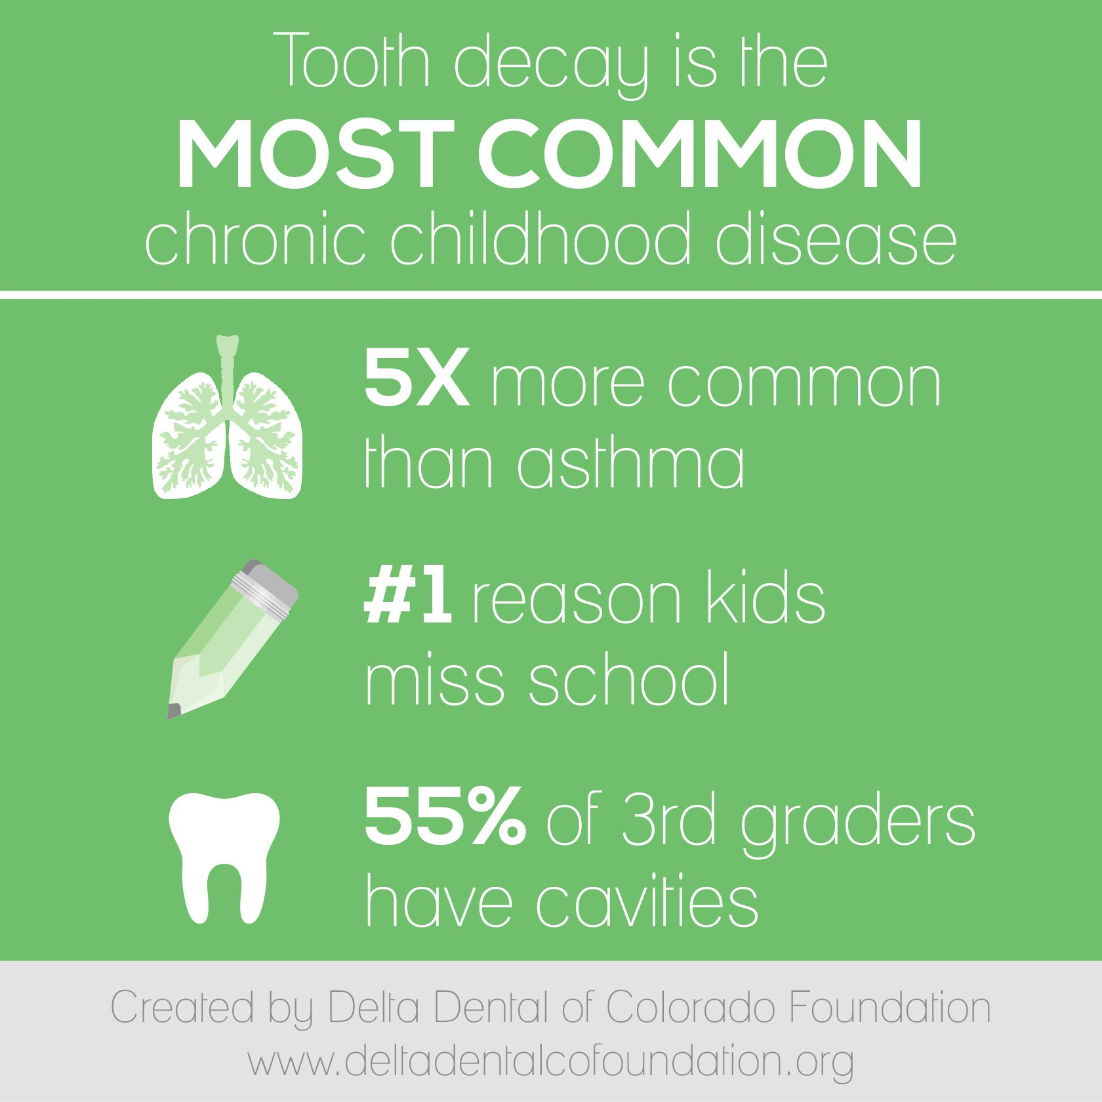
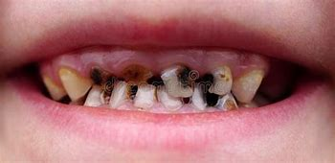
Cavities are preventable!

Slide 47
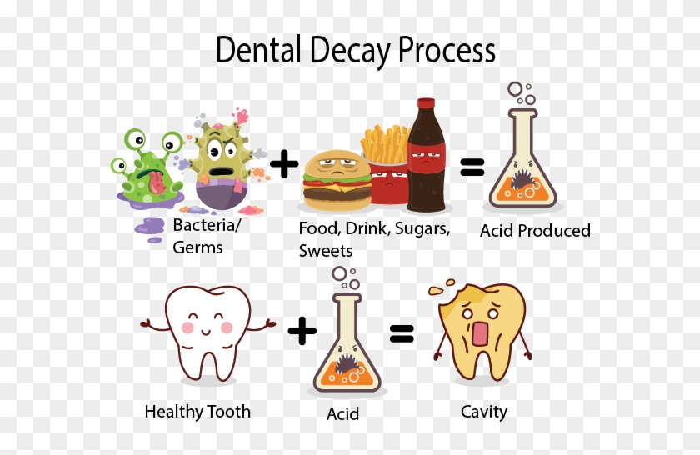
Dental Decay Process

Slide 48
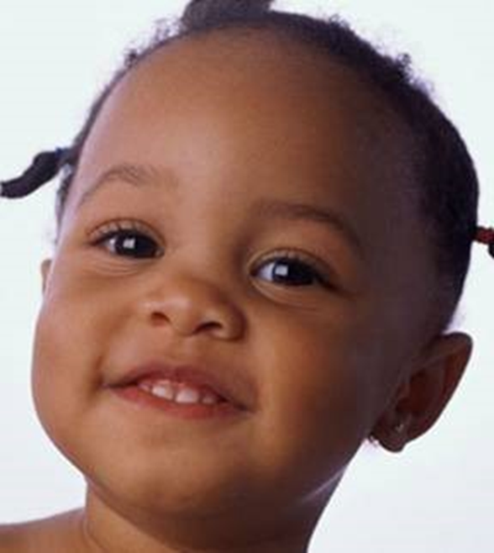
Why are primary teeth so important?
Facial Development
Chewing
Talking
Smiling
Self-esteem
Guide eruption of permanent teeth

Slide 49
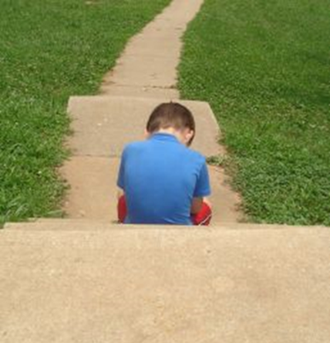
Effects of decay
Nutritional problems
Sleeping issues
Pain
Swelling
Tired or grouchy
Not wanting to smile
Inability to focus
Missed school days
Poor school performance
Poor self esteem
Impaired speech

Slide 50
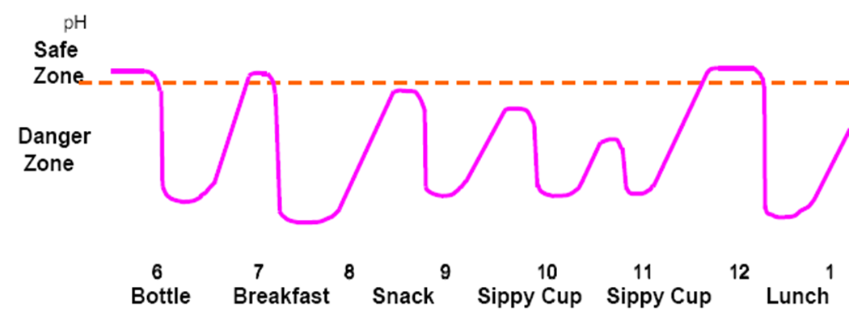

IT TAKES ABOUT 30 MINUTES FOR YOUR SALIVA TO NEUTRALIZE

Slide 51
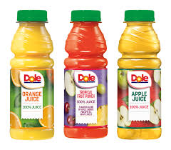
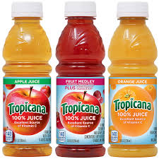

The American Academy of Pediatrics recommends fruit juice NOT be given to infants under 12 months of age.
Fruit juice offers no nutritional benefit to infants in this age group. At the same time, it can increase risk of tooth decay and cause a preference for sweeter flavors instead of plain water.

Slide 52

Hospital Dentistry

Slide 53
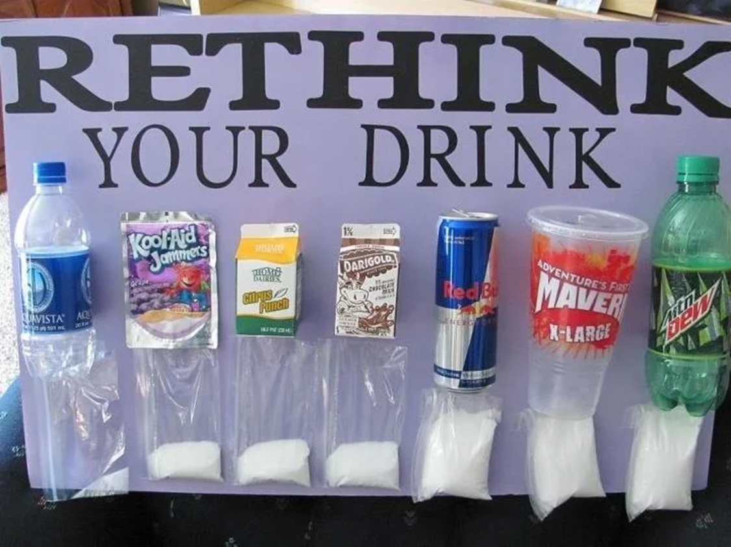

Slide 54
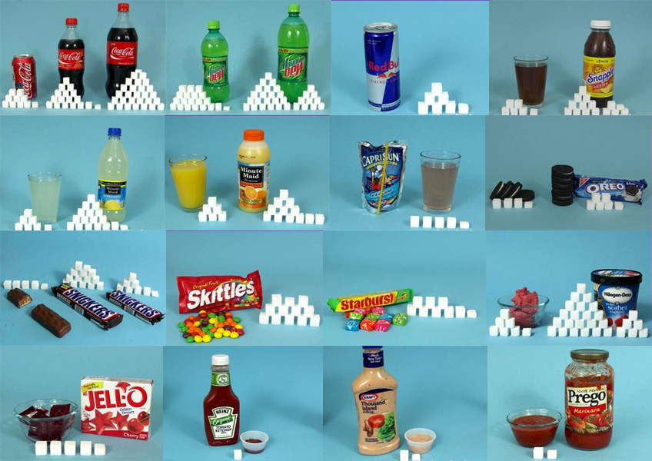

Slide 55
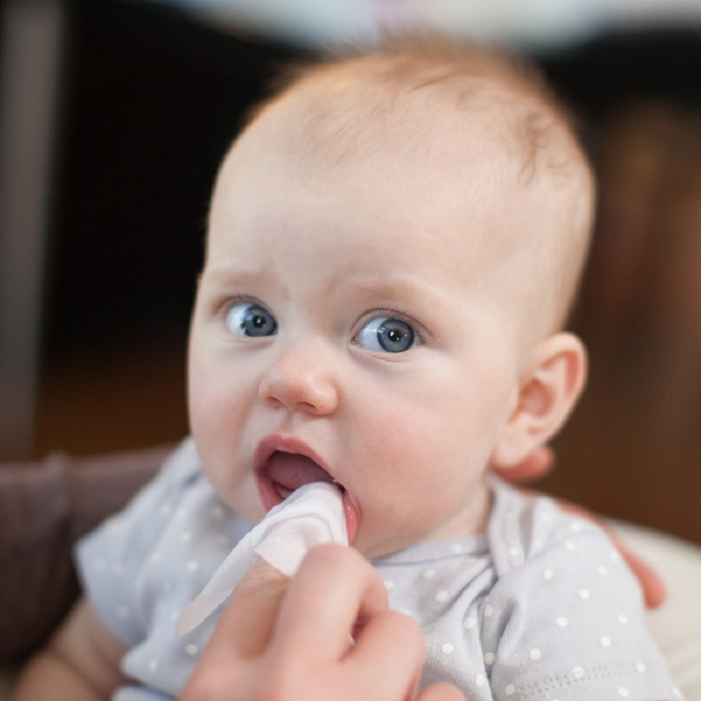
Oral hygiene instructions for babies
Clean baby’s mouth and gums with a soft cloth at bath time. This helps prepare them for the teeth cleaning to come.
Realistic expectation

Slide 56
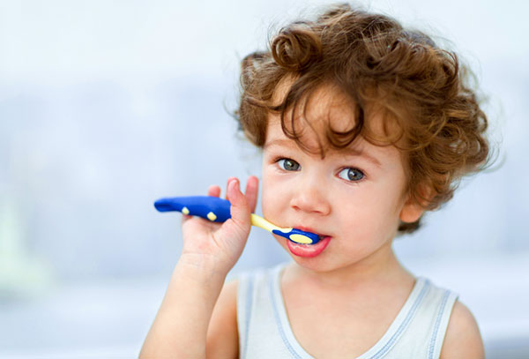
Oral hygiene for children
Brush their teeth twice a day with fluoridated toothpaste when first tooth erupts.

Slide 57
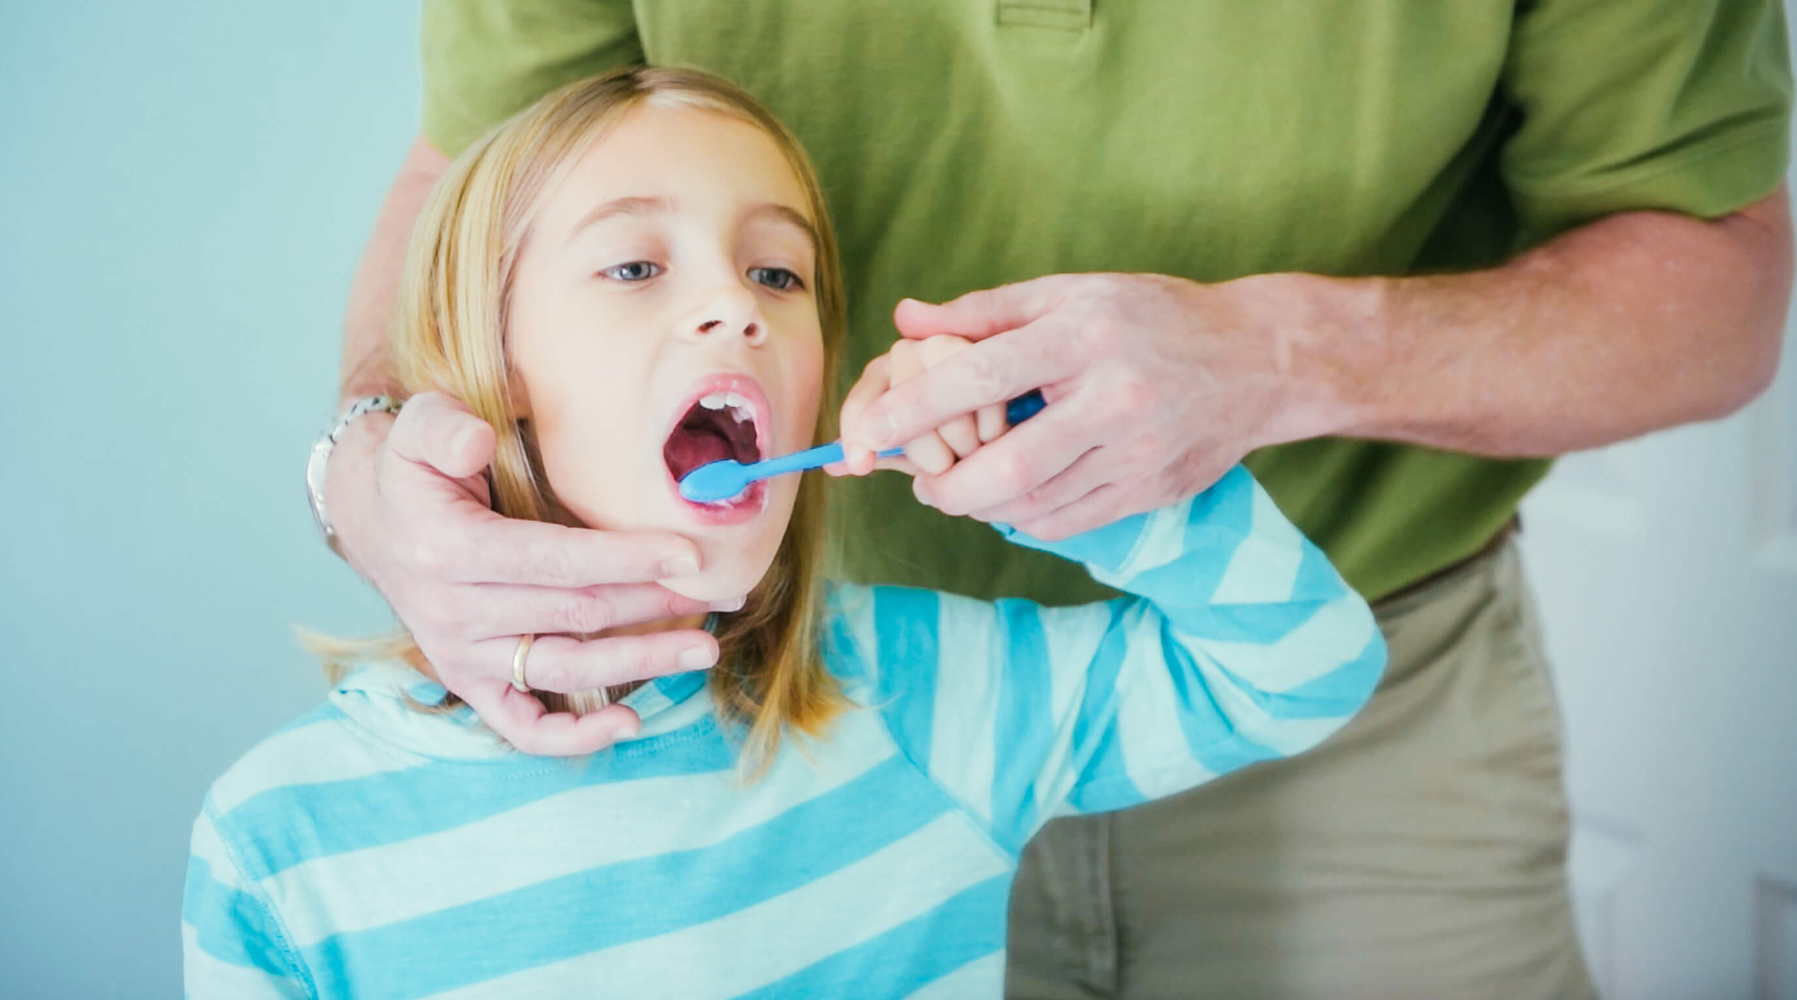
Don’t be like Zoro!

Slide 58
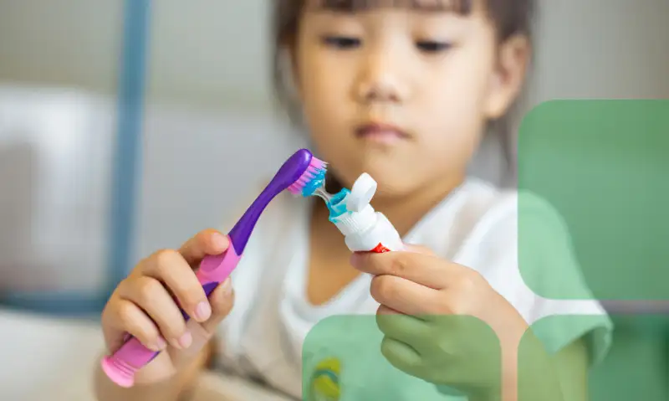
Dexterity: Little hands sometimes have a hard time wielding a toothbrush as effectively as an adult.

Slide 59
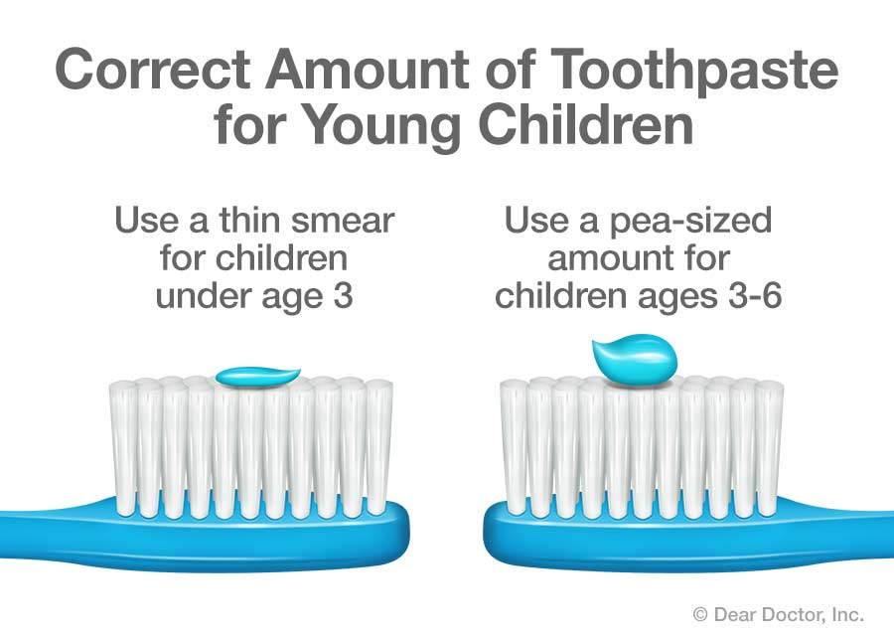
Toothpaste

Slide 60
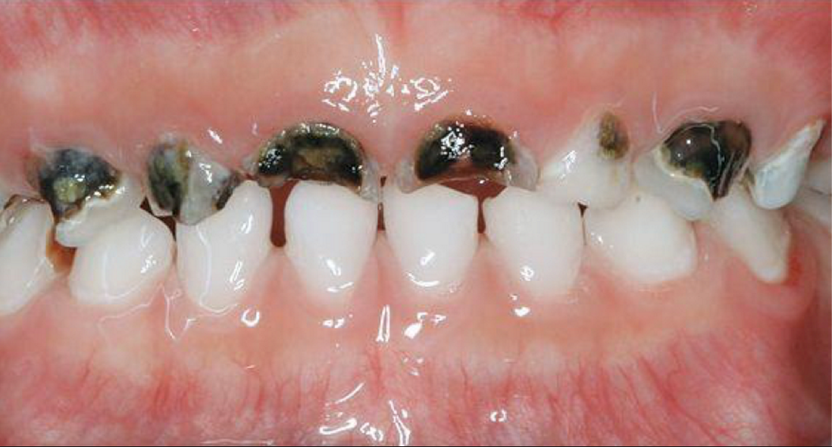
Baby Bottle Decay
Place only formula, milk or breast milk in bottles. Avoid filling the bottle with liquids such as juice or soft drinks.
If you put a baby to bed with a bottle, make sure it only contains water.

Slide 61
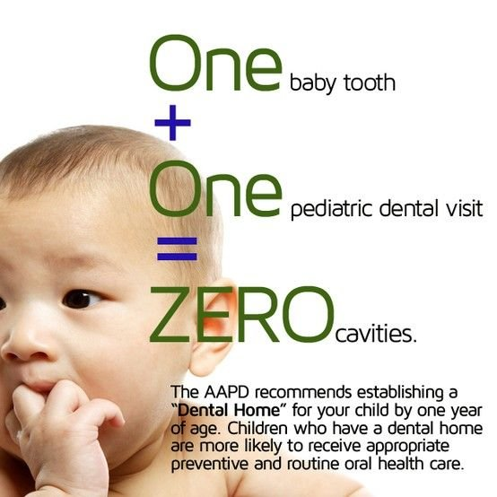

Age One Dental Visit
The American Academy of Pediatric Dentistry and the American Academy of Pediatrics both recommend that children see a dentist when the first tooth erupts and no later than 12 months of age.

Slide 62
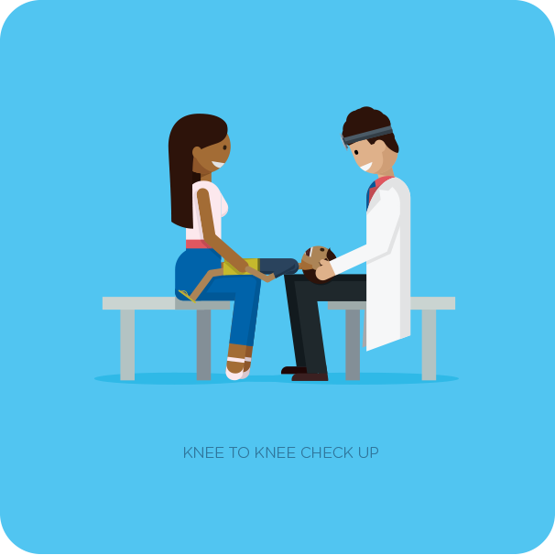
Age One Dental Visit
Infant Oral Hygiene
Normal Eruption of Teeth
Fluoride
Nutrition
Face/Jaw Growth
Risk of Cavities
Pacifier

Slide 63
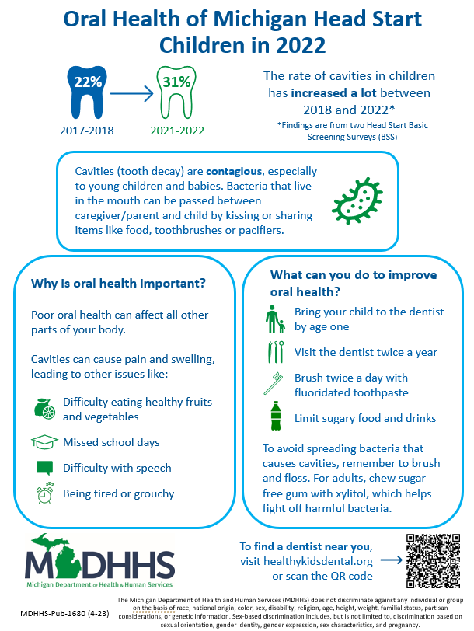

Slide 64
Dental Insurance: Who has What?
Infants and Children up to 21 years of age have Healthy Kids Dental
Medicaid= Healthy Kids Dental
Notes:
All MI kids with Medicaid have HKD
Who can tell us what HKD is?

Slide 65
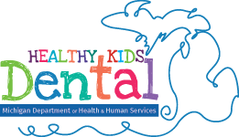
Delta Dental
Blue Cross Blue Shield Michigan/Dentaquest

Slide 66
Healthy Kids Dental
Xrays
Cleanings, Exams
Fillings
Root Canal Therapy
Partials
Extractions
Sealants, Fluoride

Slide 67
Find A Dentist
Healthy Kids Dental Program (michigan.gov)

Slide 68
Adult Dental Medicaid 21 and older
Effective April 1, 2023 increased reimbursement to 100% of the average commercial rate and increased services to include crowns, root canals and periodontal therapy.

Slide 69
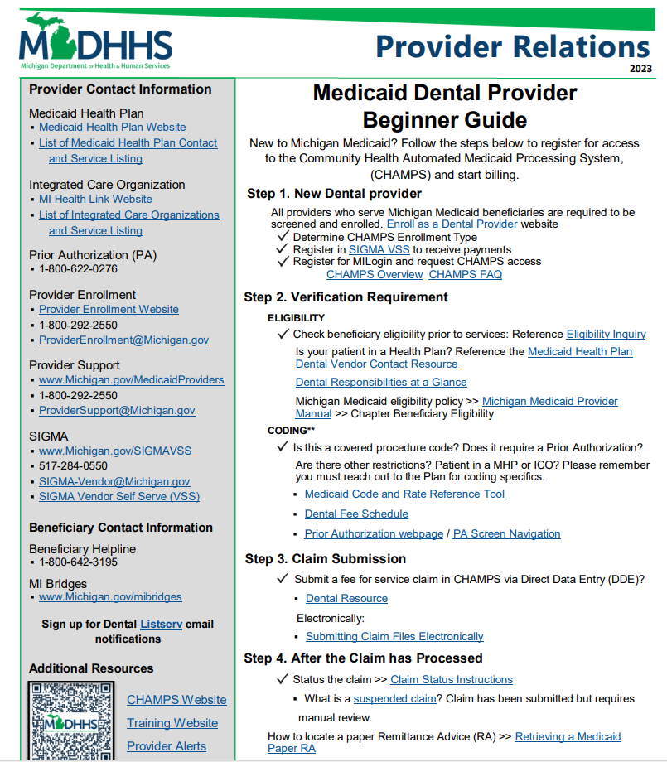

Slide 70
Aspiring Michigan Dental Providers Webinars
Recorded and posted on the website.
Collaborating with the Michigan Dental Association at conferences and presenting to local associations.
Dental workforce shortage

Slide 71


Slide 72


Slide 73

Dental Therapist
New person on the dental team
Advanced Practice Clinician
Reimbursed by Medicaid
Can only practice in certain
settings and do certain procedures

Slide 74
Varnish Michigan Program
Free fluoride varnish to medical providers to use on children 0 to under 6 yrs.
Medicaid reimburses medical providers for providing oral screenings and applying fluoride varnish to their 0 to under 6 age child patients
Physicians, nurse practitioners, and physician assistants are recognized Medicaid billable medical providers for these two oral health services.
Give some basic data

Slide 75
Varnish Michigan Program
To encourage medical providers to incorporate oral screenings and apply fluoride varnish to infant and toddler teeth during well child visits.
Referral to a dental home by age 1
There is required online training that is provided.

Slide 76

Fluoride Varnish
Fluoride varnish is made with fluoride, a mineral that thickens the outer surface of teeth. It helps prevent tooth decay and slows down cavity development.
Vitamins for your teeth.
Easy to apply
Can prevent tooth decay, slow it down or stop it from getting worse.

Slide 77



Slide 78


Slide 79
References
Centers for Disease Control and Prevention. 2021. Disparities in Oral Health | Division of Oral Health | CDC
Delta Dental. 2023. Oral Health Conditions | Delta Dental
Michigan Department of Health and Human Services. 2023. Varnish! Michigan Free Fluoride Varnish Program for Medical Providers
American Academy of Pediatric Dentistry. 2019. year1visit.pdf (aapd.org)
American Academy of Pediatrics. 2017. Weighing in on fruit juice: AAP now says no juice before age 1 | AAP News | American Academy of Pediatrics
American Dental Association. 2014. Fluoride Toothpaste for Young Children Guideline | American Dental Association (ada.org)

Slide 80
Thank you
Heather Beavers MM, RDH​
MDHHS Early Child Oral Health Specialist
beaversh1@michigan.gov

