Slide 1
Selected Design Provides:
Proposed Design at 14th Street
Proposed Design at Trumbull Street
Dedicated transit lane with space for autonomous vehicles
One vehicle travel lane/direction
Left-turn/U-turn at signalized intersections
Sidewalk-level bike lanes on both sides of the street
Extra sidewalk space
Use of brick pavers in some corridor locations
Maintenance of traffic (MOT): access for vehicles, pedestrians and bicyclists to corridor businesses to be maintained during construction

Slide 2
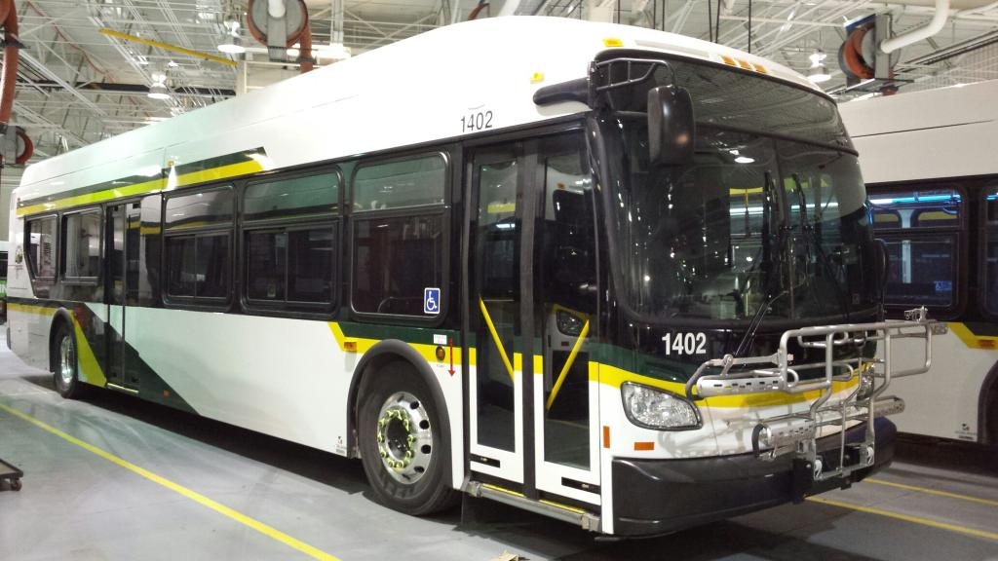
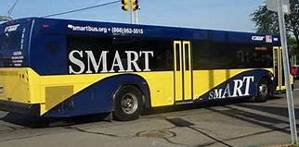
US-12 (Michigan Avenue) Transit Facts
Both DDOT and SMART operate bus service in the corridor
Rosa Parks Transit Center located on the east end of the corridor
More than 25 routes operate in or across the project corridor
Three routes operate the entire length of the project corridor
  DDOT Route 2 - Michigan
  SMART Route 830 EB
  FAST Route 261
More than 20 stops along the corridor for the different routes
Less transit stops provide a faster, more reliable service, but more stops provide less walking distance to a destination; it is a balance of speed and reliability with walking distance.

Slide 3
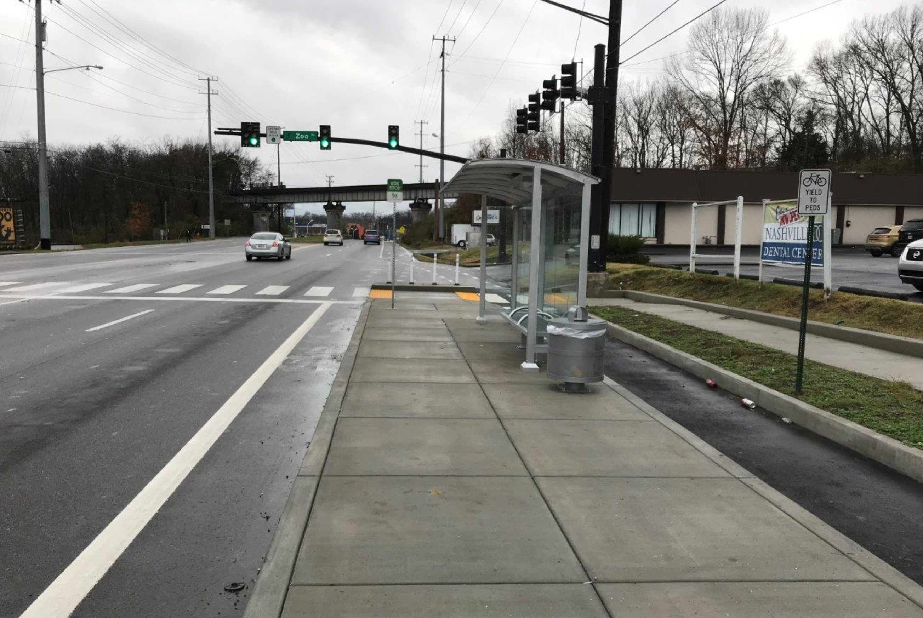
Designing a Safe Bus Station
Americans with Disabilities Act (ADA)-compliant
Easy boarding
Proper lighting
Design is currently being developed
Example

Slide 4
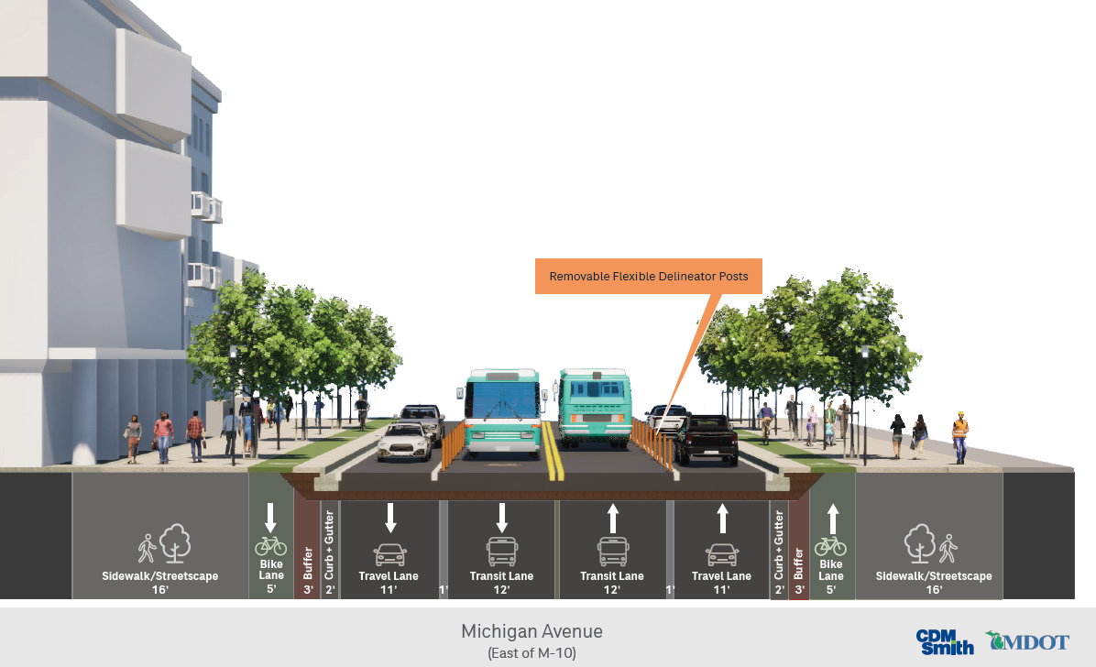
Typical View of US-12 (Michigan Avenue) East of M-10

Slide 5
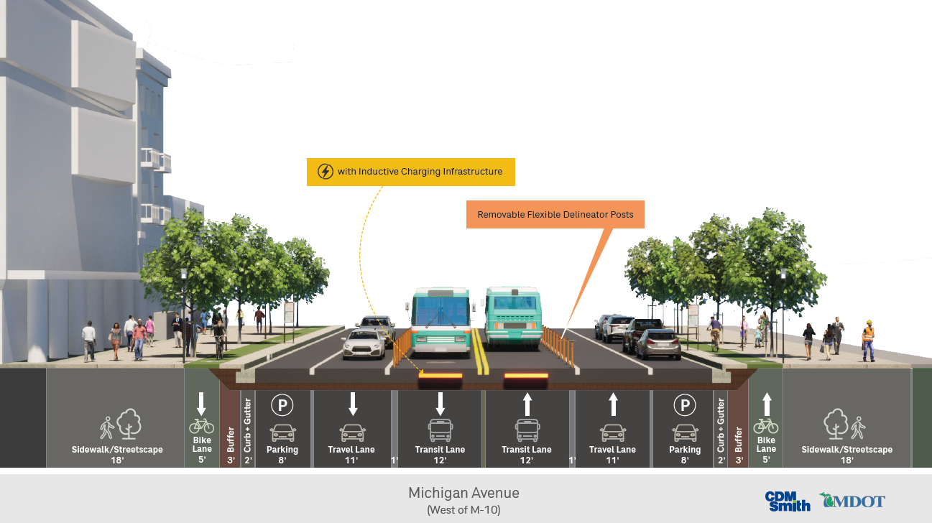
Typical View of US-12 (Michigan Avenue) West of M-10

