Slide 1
TB Nurse network meeting July 17, 2024
Call-in Option
Dial: 248-509-0316
Conference ID: 718 459 655#

Slide 2
Meeting Basics
Please keep yourself muted unless presenting or asking a question.
If you are having problems with audio, you can utilize the call-in option and that information is listed in the Teams invite.
Put any questions in the chat or raise your hand during the designated Q&A time and we will call on you.
This meeting is being recorded. Links to the recordings and slides will be posted on the TBNN webpage.
Do not mention any patient names or identifiable information.

Slide 3
Agenda
Updates
Survey Results
Training Opportunities
New Resources Available
New Publications
Isolation Guidelines Presentation
Questions/Open Forum

Slide 4
Program Updates
CDC new website launch
Links may no longer work; content has been changed
Please let us know if you need help finding anything
TB Elimination Plan posted to website
TB seminars paused for the summer
TST workshop updates

Slide 5
TB Nurse Network Survey Results
Survey sent to TBNN members in June
Asked for feedback on the meetings and suggestions for future meetings
Collected some demographic information from respondents
42 responses
37 – have attended TBNN meetings before
5 – have never attended a meeting before

Slide 6
Notes:
Top responses:
New resources or materials available
TB related news
Presentations

Slide 7
Notes:
Top responses:
Presentations on nurse case management best practices/tips and tricks
Case presentations from public health nurses
Upcoming training opportunities
Information about available resources or materials
1 “other” response – “Any updates/changes to treatment/management recommendations”
Options that got cut off: Presentations on TB basics (LTBI vs. TB, treatment options, etc.), Review of reporting and/or referrals (MDSS data entry, IJNs, etc.), Presentations from other programs or partner organizations.

Slide 8
Q4: Requested Presentation Topics
EDN referrals and immigration processes (refugee, U4U, status adjusters)
MDSS data entry
Cultural information on cultures most commonly served in MI
Challenging cases
New resources, gold standards of practice, or treatments
Best practices from the field that can be applied to case management
Interpretation of IGRA result
Less common cases – eye, bone transplants, MDR or XDR, etc.
Help in acquiring meds (bedaquiline)
LTBI challenges (treating children, engaging providers, data entry)
Notes:
Responses have been condensed.

Slide 10
Q6: Other Suggestions or Comments
Instead of open forum, invitation to write in prior to meeting
Info on managing MDRs
Great info provided at these meetings
Not able to consistently attend due to other work demands

Slide 12
Q7 & Q8: Other Responses
Q7: Work Setting, “Other”
Ambulatory Care Organization
University Health Service
Fire Department
Retired, still doing classes
TB clinic
Laboratory
Correctional Facilities
Behavioral Health
Q8: Current Role, “Other”
Nurse Practitioner
TB/Public Educator
Program Supervisor
Lab Manager
Nurse Educator

Slide 13
Survey Results - Conclusion
Thank you to all who completed the survey!
The feedback will be used when planning future meetings
Feel free to reach out if you have additional feedback or did not get a chance to complete the survey
If you are interested in presenting on a case or a specific topic, please send me an email and we can discuss
For the open forum – we can look at creating an anonymous submission form

Slide 14
TB Training Opportunities - Virtual
Understanding the IGRA: What You Need to Know – Webinar from Heartland 08/01
Bridges to Build: TB in the Pacific Islander Community within the Continental US – Webinar from Curry 08/08
TB Contact Investigation Essentials for Healthcare Professionals – Webinar from Mayo 07/26
Engage, Empower and Support Informal TB Care-Givers – Webinar from TBPPM 07/19
TB ECHO through WA State DOH
Weekly sessions throughout 2024
Recorded sessions available
International Workshop on Clinical Pharmacology of TB Drugs
October 1-2, 9 am-12:45 pm EST
Achieving Treatment Completion for Drug-Susceptible TB – Webinar from Curry
Fall 2024, dates TBD
TB 101 Webinar Series – weekly through September 6

Slide 15
TB Training Opportunities – In-Person
TB PEN/ETN Conference – September 17-19 in Atlanta
Registration ends 08/16
TB Intensive Workshop - September 10-13 in Newark, NJ
TB Clinical Intensive - October 9-10 in Rochester, MN
Virtual option available
National TB Conference – June 2-6, 2025, in Atlanta, GA
Notes:
TB PEN/ETN (Program Evaluation Network and Education and Training Network)

Slide 16
Archived Trainings
Hansen’s Disease (Leprosy) Today: Ending Stigma, Embracing Dignity
Mayo Innovations in TB Series Recordings:
TB and Mental Health
TB and Diabetes
TB Diagnostic Strategies
Pediatric TB: Radiologic Considerations
Therapeutic Drug Monitoring
Wisconsin TB Summit: Recorded sessions now available

Slide 17
New Resources Available
Compounding Pharmacy Fact Sheet
Includes links to compounding pharmacy resources: PCCA Find A Compounder Search Tool, APC Find A Compounder
We Are TB and Somos TB flyers
New SNTC Cultural Quick Reference Guides available for Brazil and Honduras

Slide 18
New Publications
Progress Toward TB Elimination and TB Program Performance – NTIP, 2016-2022
CDC surveillance summary looking at a 5-year relative change for TB program performance
NTCA Guidelines for Respiratory Isolation and Restrictions to Reduce Transmission of Pulmonary TB in Community Settings
Updated version of Testing and Treatment of LTBI in the United States from NTCA/NSTC
Third edition, published November 2023

Slide 19
Isolation guidelines presentation

Slide 20
New TB Isolation Guidelines for Community Settings
Peter Davidson, Ph.D.

Slide 21
Mission
MDHHS provides services and administers programs to improve the health, safety, and prosperity of the residents of the state of Michigan.

Slide 22
New Guidelines Available
Clinical Infectious Disease, April 18, 2024. “NTCA Guidelines for Respiratory Isolation and Restrictions to Reduce Transmission of Pulmonary Tuberculosis in Community Settings”
https://doi.org/10.1093/cid/ciae199

Slide 23
Prior Guidance
Multiple older references, none dedicated to respiratory isolation in community settings for pulmonary TB.
Primary reference: 2005 MMWR Guidelines for Preventing Transmission of TB in Health-Care Settings.
General training materials for public health staff and clinicians; all consistent with 2005 MMWR.
2005 criteria for release from respiratory isolation (proxy for defining non-infectiousness):
At least 14 days appropriate treatment, AND
3 consecutive negative sputum smears, AND
Evidence of clinical improvement

Slide 24
Gaps in 2005 Criteria
Focused on healthcare settings & release from hospital airborne isolation.
Applied in home or community settings, frequently led to extended isolation.
AFB smears often remain positive or alternate pos/neg long after 14 days of treatment. AFB smear status is a poor indicator of transmission risk after treatment is started.
Did not account for rapid killing of TB once treatment is started.
Burdensome, unpleasant and punishing for patients/families.
Stressful and ethically challenging for public health.

Slide 25
Development of New Guidelines
National TB Coalition of American (NTCA) convened a workgroup in 2022 to create new guidance.
Physicians; Nurses; Program Managers; Epidemiologists; TB Survivors; Bioethicists. Representing public health and hospital practice; state and local/city public health programs; bioethics and public health law.
Focus on Community Settings.
Distinct from healthcare, congregate, or other high-risk settings (guidance already existed).

Slide 26
Key Recommendations For Community Respiratory Isolation

Slide 27
Rec 1: Goals of Respiratory Isolation & Restrictions
1.1: Consider potential benefits and harm for community & Patient.
Remember that any form of isolation or restriction is contrary to constitutional liberties.
Benefit(s) to the community?
Do they clearly outweigh the Patient’s loss of liberty? Detriment to financial, housing, food security? Mental health and stigma?

Slide 28
Rec 2: Define Respiratory Isolation & Restrictions
2.1: Should be spectrum of tailored restrictions, individualized for circumstance.
“Respiratory Isolation” is not a single or uniform standard.
Some activities may be safe for community and beneficial for Patient. Other activities may not be safe enough for community or beneficial enough for Patient.
Less restrictive measures should be favored if they appropriately balance the interests of the community and the Patient.

Slide 29
Examples of “Levels” of Respiratory Isolation
EXTENSIVE |  | MID / MODERATE |  | NO / NONE
Strictly limit movement |  | Most of time at designated location |  | No restrictions; full daily activities as usual
Full home isolation |  | Most outdoor activities allowed; allow limited essential indoor activities.
If leave, mask and/or extra ventilation |  | Mask and/or extra ventilation indoors
Strictly limit visitors |  | Visitors if permitted by LHD + wear mask

Slide 30
Rec 3: Determine Infectiousness & Transmission Risk
3.1: Prior to effective treatment, Patients with higher respiratory bacterial burden considered relatively more infectious than Patients with lower bacterial burden.
Individual variability
Sputum smear and/or NAAT positive
Cavitation on chest imaging
Helps to tailor respiratory isolation measures to each Patient.

Slide 31
Rec 3 cont’d
3.2: Patients on <5 days of effective treatment considered relatively more infectious than Patients on >5 days of effective treatment.
3.3: Patients on >5 days of effective treatment considered non-infectious or low likelihood of infectiousness, regardless of sputum bacteriologic status (smear/NAAT/culture), with certain exceptions.
Clinical studies and meta-analyses indicated >95% bacterial killing within 48-72 hours of starting effective treatment.
Author group felt 5 days effective treatment is sufficient to remove most Patients from respiratory isolation.

Slide 32
Rec 3 cont’d
3.4: Risk of transmission is multifactorial.
Patient’s infectiousness
Environment of exposure(s)
Proximity, Frequency, Duration of exposure(s)
Biological Susceptibility of Contacts.
Each Patient, Exposure scenario, and Contact is unique. Not one size fits all.

Slide 33
Schematic of Infectiousness +/- Respiratory Isolation
INFECTIOUSNESS |  |  | DETERMINE RESP ISO | LEVEL OF RESP ISO
Rx Status | Pre-Rx Bact Burden | Est Pt Infectiousness | Resp Iso Indicated? | What Level of Resp Iso to Choose?
Pre-Rx | High | Highest | Yes | Extensive
 | Low | Moderate | Yes | Extensive or Moderate
Rx <= 5 days | High | Moderate | Yes | Moderate
 | Low | Moderate/ Low | Yes | Moderate
Rx > 5 days | High | Low | Not indicated in most situations | None
 | Low | Lowest |  | None

Slide 34
Rec 4: Determine If Community-Based Respiratory Isolation is Indicated
4.1: Respiratory Isolation not recommended for Patients who are non-infectious.
4.2: Respiratory Isolation generally not recommended for Patients with pulmonary TB on effective treatment and low likelihood of infectiousness.
Exceptions: High-risk community settings and/or populations.
4.3: Respiratory Isolation may be considered for Patients likely to be infectious and there is higher risk of transmission.

Slide 35
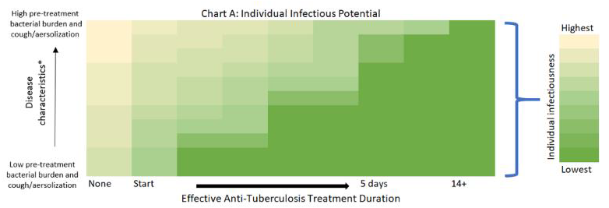
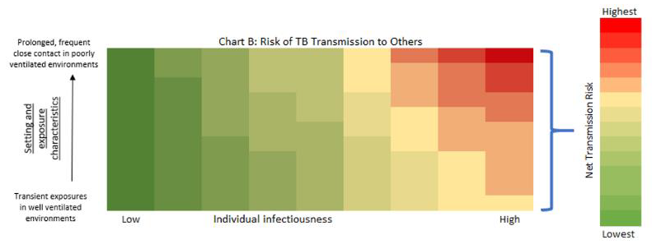
Assessing Infectiousness & Risk Of Transmission

Slide 36
Rec 5: Determine Level of Respiratory Isolation
5.1: Moderate or “Partial” Respiratory Isolation is appropriate for most Patients and in most situations.
Allow for individual exceptions.
5.2: Level of Respiratory Isolation (Low, Moderate, Extensive) and duration should be reassessed frequently for each Patient.
Modify based on individual considerations or changing circumstances.
5.3: Any Patient under Respiratory Isolation should be offered assistance to mitigate anticipated harms of isolation.
Consult Local Health Department and/or MDHHS TB Unit.
Patients should generally be allowed to participate in activities or situations in which there is not a reasonable risk of transmission.

Slide 37
Thoughts For Applying New Guidelines

Slide 38
Community vs High Risk vs Congregate?
Easy Ones
Classical examples of Congregate
Hospitals
Correctional
Recovery / Halfway / Supervised Housing
Shelters
High Risk (may or may not be Congregate)
Skilled Nursing Facility / Nursing Home
Dialysis / Infusion Center
Classical examples of Community
Individual / Private residence
Apartment / Condominium (each unit is its own space)
Anything NOT Congregate, Healthcare, or High Risk
Tricky Ones
College/University Dormitory
More shared space than Apartment (bathrooms, pod rooms, dining hall)
Elementary / Middle / High Schools
Cohorts or “Rooms” have same schedule: extensive shared time throughout day
Shared bathrooms, lunchrooms
Movie theater?
Close quarters, but enough time???
Indoor concert or live theater?

Slide 39
Questions? Confused? HELP!?
Request Clinical Consultation: Physician Consulting (michigan.gov)
Call us!
517-335-8165

Slide 40
Questions or discussion?

Slide 41
Wrap-Up
Thank you all for attending!
Recording and slides will be posted to the TBNN webpage.
Thanks to those who completed the survey! Feedback will be used to plan future meetings.
Please reach out to berlinc@michigan.gov if you are interested in presenting at a future TBNN meeting or have any questions.

