Slide 1
TB and HIV Overview for World TB Day March 2022
James Sunstrum, M.D.
Wayne County TB Clinic

Slide 2
2022 MDHHS World TB Day
Virtual Conference
March 24, 2022
Disclosure
Denise Parr
Isagenix International (Sales)
Western Michigan University Homer Stryker M.D. School of Medicine adheres to the ACCME’s Standards for Integrity and Independence in Accredited Continuing Education. Any individuals in a position to control the content of a CE activity, including faculty, planners, reviewers or others are required to disclose all relevant financial relationships with ineligible entities (commercial interests). All relevant conflicts of interest have been mitigated prior to the commencement of the activity.
Accreditation
In support of improving patient care, this activity has been planned and implemented by Western Michigan University Homer Stryker M.D. School of Medicine and Michigan Department of Health and Human Services. Western Michigan University Homer Stryker M.D. School of Medicine is jointly accredited by the Accreditation Council for Continuing Medical Education (ACCME), the Accreditation Council for Pharmacy Education (ACPE), and the American Nurses Credentialing Center (ANCC), to provide continuing education for the healthcare team.
Credit amount subject to change. Interprofessional Continuing Education
This activity was planned by and for the healthcare team, and learners will receive 5.0 Interprofessional Continuing Education (IPCE) credits for learning and change.
Physicians
Western Michigan University Homer Stryker M.D. School of Medicine designates this live activity for a maximum of 5.0 AMA PRA Category 1 Credits™. Physicians should claim only the credit commensurate with the extent of their participation in the activity.
Nurses
Western Michigan University Homer Stryker M.D. School of Medicine designates this activity for 5.0 contact hours for nurses. Nurses should claim only credit commensurate with the extent of their participation in the activity.
Activity Code: 24227

Slide 3
HIV and TB: 2 serious infections
Rules of the game:
1. All HIV patients should be tested for latent TB infection.
2. All active TB patients should be tested for HIV.
3. If pulmonary infiltrates found with HIV+, keep TB in differential diagnosis.

Slide 4
1. All HIV patients should be tested for latent TB infection.
PPD or Quantiferon on baseline
Low CD4 may result in false negative test
If negative, repeat based on risk… ? Every 2-3 years?

Slide 5
If PPD or IGRA are positive in HIV+ patient
Chest X-ray
Symptom review for fever, cough, adenopathy
Any mass, or any central nervous system abnormality should be evaluated….
If negative, treat for latent TB
With daily isoniazid, any ARV regimen can be used.

Slide 6
Latent TB treatment for HIV+ patient
www.aidsinfo.nih.gov
Newer weekly INH/rifapentine or rifampin regimen not recommended together with dolutegravir, bictegravir or protease inhibitors
Thanks to LTBI treatment, few HIV patients develop active TB in Michigan

Slide 7
Active TB in HIV+ patients in Michigan
1-2 cases a year (out of 130 cases total)
Tend to be foreign born HIV patients
Tend to be recent arrivals in USA

Slide 8
New patient in your HIV waiting room…
Tested HIV+ on Immigration screen
Came from Sierra Leone 8 months earlier
Dry cough x 2 months
Baseline CD4 = 50 cells
This is her chest Xray:

Slide 9
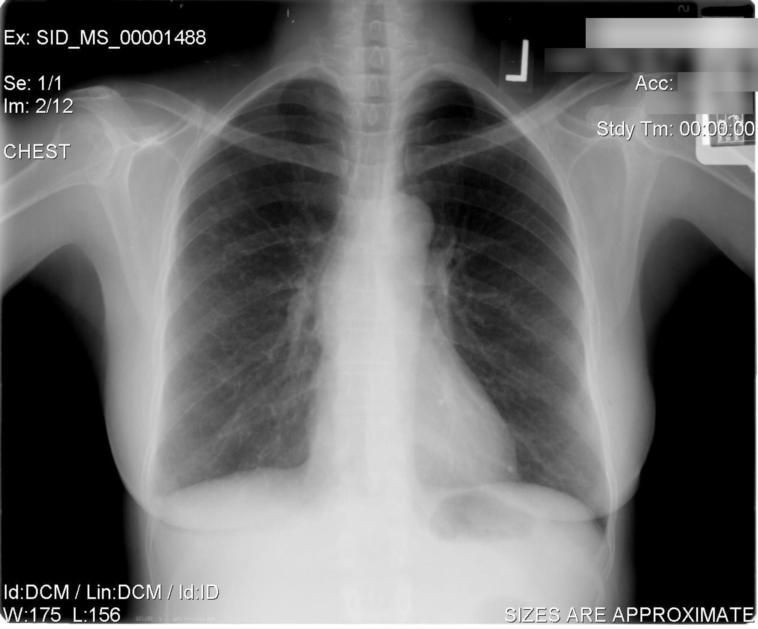

Slide 10
Her sputum grew Mycobacterium tuberculosis !
Due to low CD4 count, inflammatory response is limited. Xray may show little or no infiltrate.
We kept her out of the regular HIV clinic for 2 months, until TB intensive phase of treatment completed.

Slide 11
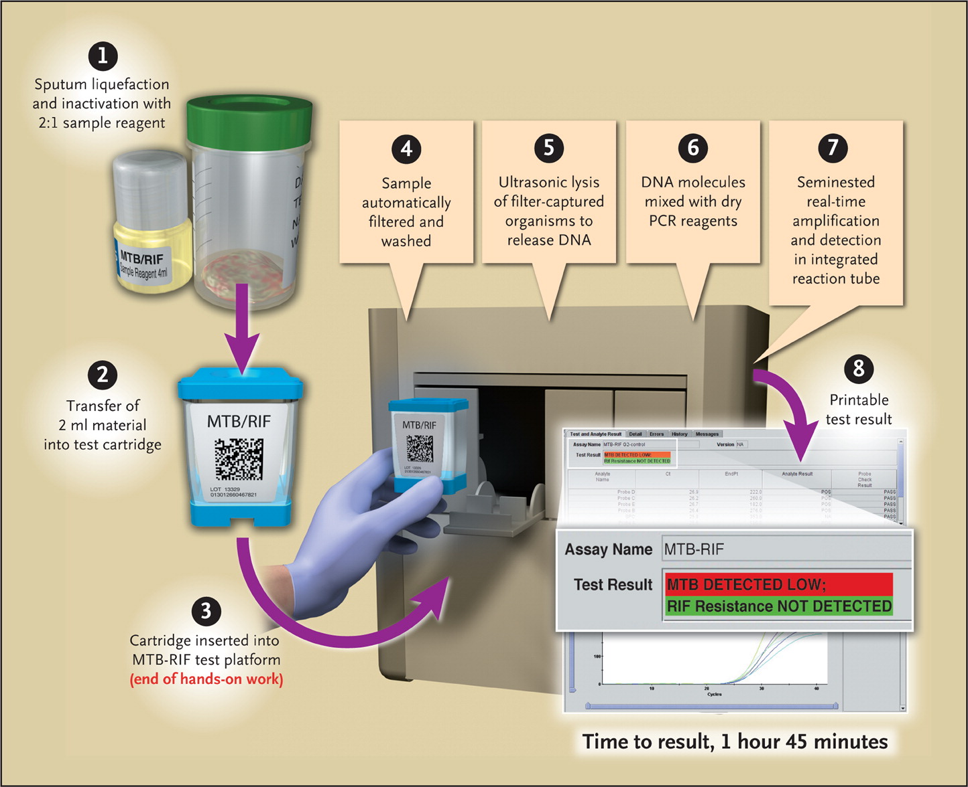
Boehme CC et al. N Engl J Med 2010;363:1005-1015.
GenExpert Assay Procedure for the MTB/RIF Test.

Slide 12
TB may not look at all typical in HIV patients
Unusual chest X-ray findings
May have a NORMAL chest X-ray !
25% of TB will be extra-pulmonary
Be especially wary in foreign-borne patients with HIV

Slide 13
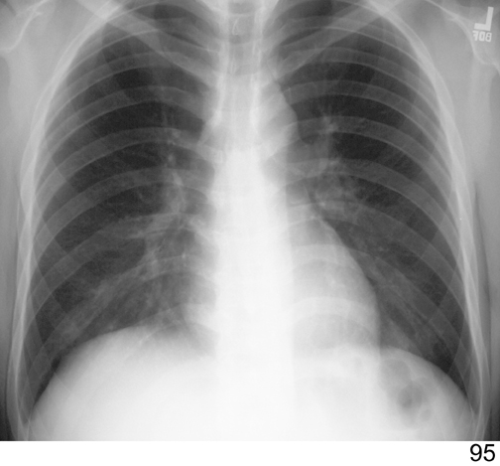
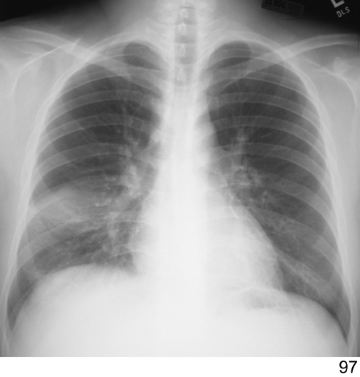
IRIS commonly occurs in association with Mycobacterium tuberculosis, Mycobacterium avium complex (MAC), cytomegalovirus (CMV), Cryptococcus. May occur with Pneumocystis, Toxoplasma, hepatitis B and C, human herpes virus 8 (which causes Kaposi sarcoma), and JC virus (which causes progressive multifocal leukoencephalopathy, PML).
Paradoxical Reaction IRIS Worsening Radiograph 6 weeks following Initiation of HIV therapy

Slide 14
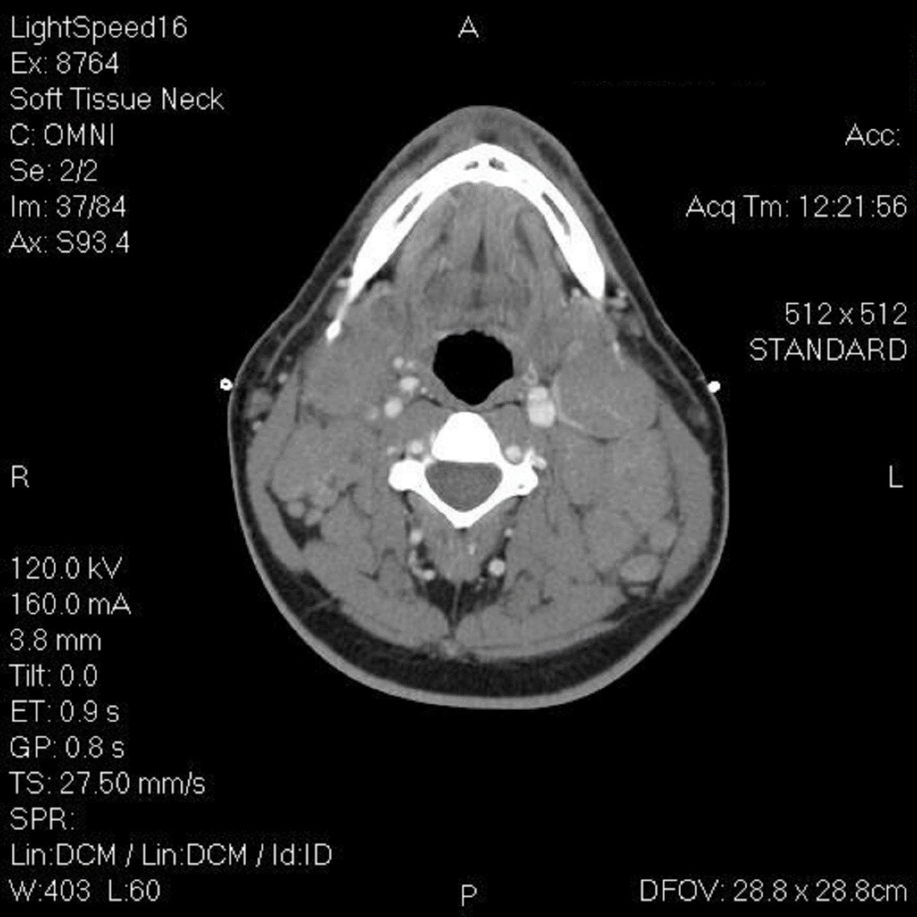
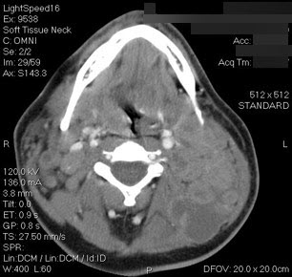
AIDS + node TB diagnosed January 18 CD4 = 30
Rx HIV and TB January 18:
Feb. 23: diffuse rash, neck drainage

Slide 15
Best Time to start HIV meds in a HIV-TB patient?
INTENSIVE
(Or INITIAL)
PHASE
HRZE
(RIPE)
2 months
CONTINUATION PHASE
INH, rifampin
4 months
?
?
?
?

Slide 16
New TB in Untreated HIV patient
CD4 <50
CD4 >50
INH, Rifampin, Pyrazinamide, Ethambutol
Start HIV therapy within 2 weeks due to high risk of other AIDS complications
Monitor for IRIS
INH, Rifampin, Pyrazinamide, Ethambutol
Start HIV therapy within 2 – 8 weeks
Monitor for IRIS

Slide 17
Call for advice
MDHHS Consultants
Global TB Institute at Rutgers University, Newark, NJ 1-800-4TBDOCS (800-482-3627)

