Slide 1
Mandated Reporter Training
Children’s Protective Services (CPS)
Notes:
Review how to use Webinar during Train the Trainer Training. Google Chrome and Internet Explorer work.
The content of the slide presentation must remain static with the exception of slides that are locally nuanced (slide #2). Please send any curriculum feedback to parksc@michigan.gov.
As needed, instructors may use the “Instructor Notes” section of the slides to input their own specific reminders/notes as needed based upon audience requirements.
There will be an error message when opening powerpoint stating: “References to external media object have been blocked.”
Click “enable content” to allow a video to show within slide 21. The video is also located at Michigan.gov/mandated reporter under resources.

Slide 2
Name of Local Organization
Local Organization Logo Here
Identifying information for Local Organization
Person Facilitating Session
Notes:
Update to specify local county information.
Hide slide if not applicable

Slide 3
Training Objectives
After successful completion, trainees will:
Understand mandated reporting.
Know components of the Child Protection Law (CPL).
Recognize certain signs of child abuse and neglect.
Know the MDHHS reporting process.

Slide 4
State Law Child Protection Law, 1975 PA 238
The Michigan Child Protection Law, 1975 PA 238, requires the reporting of suspected child abuse and neglect by certain persons (called mandated reporters) and encourages the reporting of suspected child abuse and neglect by all persons.
Notes:
CPL also includes the legal requirements for reporting, investigating, and responding to child abuse and neglect cases.

Slide 5
Mandated Reporters
People in the following professional roles are required to report suspected child abuse or neglect:
Medical and health care providers
Social workers and counselors
Childcare providers
Clergy and faith leaders
Law enforcement
School administrators and teachers
Notes:
Full list: A physician, dentist, physician’s assistant, registered dental hygienist, medical examiner, nurse, person licensed to provide emergency medical care, audiologist, psychologist, marriage and family therapist, licensed professional counselor, social worker, licensed master’s social worker, licensed bachelor’s social worker, registered social service technician, social service technician, a person employed in a professional capacity in any office of the friend of the court, school administrator, school counselor or teacher, law enforcement officer, member of the clergy, regulated child care provider, or any employee of an organization or entity that, as a result of federal funding statutes, regulations, or contracts would be prohibited from reporting in the absence of a state mandate or court order (e.g., domestic violence providers).
When speaking to DHHS personnel include the following:
Eligibility Specialist, Family Independence Manager, Family Independence Specialist, Social Services Specialist, Social Work Specialist, Social Work Specialist Manager and Welfare Services Specialist.

Slide 6
Types of Child Abuse and Neglect
Physical abuse
Sexual abuse
Mental injury
Physical neglect
Maltreatment

Slide 7
State Law: Definition of Child Abuse
Harm or threatened harm to a child’s health or welfare that occurs:
By non-accidental physical or mental injury, sexual abuse, sexual exploitation or maltreatment,
To a child under 18 years of age,
By the child’s parent, legal guardian, or other person who is responsible for the child’s health or welfare.
Notes:
Alleged perpetrator examples could also include:
A teacher
A teacher’s aide
A member of the clergy
Baby sitter, etc.
Person responsible:
Parent
Legal Guardian
Person 18 years of age or older who resides for any length of time in the same home in which the child resides, or
Non-parent adult
Substantial and regular contact with the child.
Close, personal relationship with the child’s parent/person responsible for the child’s welfare.
Is not the child’s parent or otherwise related to the child by blood or affinity to the third degree.
Person who holds a foster home/day care license and/or is an employee/volunteer in a licensed home/facility

Slide 8
Recognizing Physical Abuse
Physical abuse is a non-accidental injury.
Physical abuse indicators may include:
Bruises
Bruises on an infant are suspicious for abuse.
Burns
Broken bones
Injuries that are patterned, would not occur through normal play, and are symmetric on multiple planes of the body
Notes:
Local data can be added in text box as a means of comparing local child abuse and neglect statistics to national data.

Slide 9
Non-Accidental vs. Accidental
Non-Accidental
Parent or other household member hit or shook a child hard enough to cause injury.
Injuries are inconsistent with the explanation provided.
Bruising on an infant may be suspicious for abuse.
Accidental
Child was injured during normal child play.
Parent or other household member inadvertently injured the child.

Slide 10
Recognizing Mental Injury
An existing pattern of physical or verbal acts and omissions that result in a psychological or emotional injury.

Slide 11
Recognizing Mental Injury
Signs can include:
Depression, anxiety or suicide.
Lack of attachment.
Fear of abandonment or safety.
Fear that life or safety is threatened.
The parent or caretaker may:
Constantly criticize, punish or demean the child.
These behaviors are persistent and repetitive.
*A finding must be made by a mental health professional.
Notes:
Mental Injury:
Highly specialized
Cannot make a finding per policy without a mental health practitioner.

Slide 12
Recognizing Sexual Abuse or Sexual Exploitation
Intentional touching/contact that can be reasonably construed as being for the purpose of arousal, gratification or any other improper purpose by the perpetrator.
Sexual penetration.
Accosting, soliciting or enticing to commit, or attempt to commit an act of sexual contact or penetration, including prostitution.
Sexual abuse may not always involve sexual penetration.

Slide 13
Recognizing Sexual Abuse
Indicators:
Physical evidence (genital bruising, presence of semen, etc.).
Pregnancy or contracting a venereal disease, especially in children 12 years or younger (requires a report to CPS).
Self-reports sexual abuse.
Inappropriate sexualized behavior, outside of normal exploration relevant to age and development.
Sudden change in behavior, isolated or secretive.
Running away.
Notes:
Other indicators may include:
bloody underwear or diapers
trouble sitting or walking
excessive preoccupation or itching in the genital area
sudden change of behavior
dramatic weight change.
*Any of these indicators, when considered individually or together, may or may not be indicative of sexual abuse.

Slide 14
Human Trafficking
Sex Trafficking
Subjecting an individual to the recruitment, harboring, transportation, provision, patronizing, or soliciting for the purposes of a commercial sex act or trafficking an individual for a commercial sex act induced by force, fraud, or coercion.
Labor Trafficking
A person recruited, enticed, harbored, transported, provided, or obtained for the purposes of labor or services.
Can include domestic servitude, force labor in restaurants or salons, forced agricultural labor or debt bondage.
Notes:
If the person performing the act is under 18-years-old then they are considered victims, regardless of force.
Optional if asked or discussed:
About child sex trafficking, a question may be asked regarding whether parents are reported to CPS if they are the ones trafficking their child. Answer is yes. If they are not involved, this is not a CPS case but rather a criminal case.

Slide 15
Human Trafficking Indicators
Sexually transmitted diseases
Symptoms of post-traumatic stress
Malnourished or always hungry
Signs of physical and/or sexual abuse, physical restraint, confinement or torture
Victims and perpetrators are often skilled at concealing their situations
Live with other unrelated youth and with unrelated adults
Not in control of their own identification documents
Notes:
*Any of these indicators, when considered individually or together, may or may not be indicative of human trafficking.

Slide 16
Recognizing Maltreatment
Examples may include:
Medical child abuse.
Age inappropriate chores.
Treating a child like an animal: eating pet food from an animal food bowl.
Parent publicly announcing about a child who is bedwetting (humiliation).
Inappropriate expectations based on the child’s capability.
Child maltreatment is the treatment of a child that involves cruelty or suffering that a reasonable person would recognize as excessive.

Slide 17
State Law: Definition of Child Neglect
Harm or threatened harm to a child’s health or welfare that occurs through:
Negligent treatment, including the failure to provide adequate food, clothing, shelter, or medical care.
Placing the child at an unreasonable risk to the child’s health or welfare by failure of the parent, legal guardian, or other person responsible for the child’s health or welfare to intervene to eliminate that risk when the person is able to do so and has, or should have, knowledge of the risk.
*Does not include the inability of a parent to feed, clothe or house a child because they lack resources or supports.

Slide 18
Recognizing Neglect
Suffers from chronic dental and/or medical issues that are not being addressed.
Filthy/unhygienic or inadequately clothed on multiple occasions.
Self-reports no one is home and does not demonstrate the ability to care for themselves.
Frequent absence from school.
Steals or begs for food or money repeatedly.

Slide 19
Concerns That Do Not Involve Neglect
There are certain situations that do not require calling in a complaint to CPS:
Children who are unattended in a situation where the child(ren)’s age, development and circumstances do not indicate a likelihood of harm.
A parent or caretaker’s use of substances that does not affect their ability to care for their child.
A parent or caretaker’s mental illness that does not affect their ability to care for their child.
A parent does not comply with their court-ordered treatment plan.

Slide 20
Substance Use Concerns
Mandated Reporters must call CPS when:
They know, typically through testing of the newborn, that the newborn has a substance in their body or,
The newborn displays symptoms indicating they have a substance in their body.
This does not include controlled substances or metabolites, used for medication assisted treatment, medical marijuana or medication prescribed to the mother or the newborn.
Notes:
When the parent tests positive for substances at the birth of the child but there is no evidence (i.e. no positive infant test results or symptoms) that the newborn has a substance in their body, no complaint is required.

Slide 21
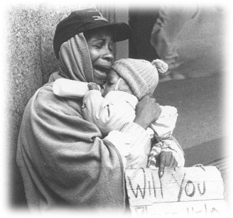
What is NOT investigated?
Head lice
Educational concerns
Issues attributed to poverty
Sibling on sibling abuse
Notes:
Taken by themselves, these examples are not indicators of neglect; they may be factors that are evaluated in other case assignments.
Poverty or inability to financially provide for their family does not constitute neglect
Discuss parents’ right to not immunize and parental right to not give psychotropic medication.
Currently under state statue, CPS does not investigate educational neglect when it is the only allegation.

Slide 22
Disproportionality
Disproportionality is the over or under representation of a certain group of people.
Child abuse or neglect exists in every racial and ethnic group, culture, economic class, and every cross section of our society.
Cultural differences do not always equate to abuse or neglect.
Ask yourself:
Would I make the same call in the same way if I saw things in the same family that reminded me of my own?
Notes:
There will be an error message when opening powerpoint stating: “References to external media object have been blocked.”
Click “enable content” to allow video to show within slide. Video is also located at Michigan.gov/mandatedreporter under resources.
Video is 9 minutes long and showcases disproportionality and bias.

Slide 23
Communities Protecting Children
Protective approaches can make meaningful differences in parenting skills and child well-being. Research has shown that these approaches help strengthen families.
Prevention efforts can be made prior to reaching CPS involvement.
Referring families to available resources may help mitigate risk, if concerns do not rise to the level of abuse or neglect.
If you know of resources available that may help a family, provide them with that information.
Notes:
Mandated reporters can help provide valuable resource information to a family before a concern reaches the level of abuse or neglect.
If they feel a resource may help a family, they do not need CPS to make that referral.
Provide examples of local resources that do not need CPS referral for involvement.
- Provide family with info on MiBridges for assistance.
- Contact 211 for available resources in the area.

Slide 24
Prevention
The Children’s Trust Fund serves as a voice for Michigan’s children and families and promotes their health, safety and welfare by funding effective local programs and services that prevent child abuse and neglect.
Learn more at www.Michigan.gov/ctf
or by calling 517-373-4320

Slide 25
Goals of CPS
The goal of CPS is to keep children safe in their homes and to provide them with a safe environment when they are determined to be unsafe.
CPS strives to keep children in their own homes when safe to do so and parent’s participation through this process is key.
Most parents want to appropriately care for their children. They have the strength to do so when supported by family or social networks in caring for their children and keeping them safe.
CPS must support families and provide them with the tools they need to be successful.

Slide 26
How to Respond When A Child Tells You Something Happened Abuse or Neglect
Move the child to a private area
Maintain eye contact
Use a soothing and supportive stance and tone
Do not display any signs of shock
Do not display signs of disapproval
Ask open ended questions (“how” and “what”)
After speaking with the child, take detailed notes about the conversation
Notes:
2nd bullet:
Discuss being culturally sensitive about the appropriateness of “eye contact”.
Suggested statements after the eye contact bullet, “Keep attentive focus on the child,” or “Thoughtful engagement with the child is important”.
Other Important Tips:
When asking open ended questions, reporters do not speak for the child.
Use words the child uses.

Slide 27
Reporting Concerns
“I don’t want to interfere in someone’s family.”
You may be the only person to intervene and ensure a child’s safety.
Notes:
Continue dialogue about the importance of providing families with information, support and resources to overcome challenges they are facing.

Slide 28
Ways to Report
Immediate report to MDHHS
855-444-3911
Be prepared to give as much demographic information as possible
Providing the family’s address is essential
Provide detailed information including statements in quotations
Michigan Online Reporting System (MORS)
State of Michigan employees: MiLogin
Outside entities: Michigan.gov/mandatedreporter
Must select link and register.
Written report (DHS-3200) within 72 hours
A DHS-3200 is not required, if utilizing MORS
Only mandated reporters are required to follow up with a DHS-3200
Notify the head of your organization if required by your employer.
Notes:
Reinforce that reporting must be immediate.
DHS-3200 allows for addition of children if using the online version. Hit tab in the child box for the child information and another row will generate. Allegations section and medical findings sections are also now unlimited if online version is used.
Remember to ask for the intake/log number prior to ending phone call and then include that log number on the DHS 3200
Remind attendees, the law states that a mandated reporter must report if they suspect child abuse or neglect, even if a supervisor tells them not to. Report, and then notify your employer, as required.
Online reporting system should not be used for child death or immediate needs such as law enforcement on scene. Phone hotline will remain staffed 24/7 and able to take calls.
SOM: MiLogin, Request Access, Michigan Online Reporting System, then request access. Once access is given, complete your profile and access through MiLogin.
Non SOM: Michigan.gov/mandatedreporter – select link and register.
Michigan.gov/mandatedreporter has user guides, FAQ, technical help information etc.

Slide 29
Detailed Reporting Requirements
Child Protection Law requires a detailed report:
“The report shall contain other information available to the reporting person that might establish the cause of the child abuse or child neglect, and the manner in which the child abuse or child neglect occurred.”
This “other information available to the reporting person” includes details known about the child, family and the specific situation. Please explain the who, what, where, when, why and how.
Complaints should still be made if not all the information is known; however, as much information that is known, must be provided.
Notes:
Ensure participants know they must include all information required when reporting CA/N on a MORS complaint otherwise the complaint may not meet abuse/neglect requirements.
An incomplete complaint does not allow CI to properly assess the need for assignment or rejection.
Michigan.gov/mandatedreporter has additional resources such as reporting requirements, MR guides, etc.

Slide 30
Provide as much detail as possible when making a report
A detailed report would be as follows:
“On 05/01/2019, Johnny reported his mother hit him four times on the right elbow with a wooden spoon. The incident happened in Johnny’s bedroom. On 05/02/2019, Johnny had a large, circular, dark purple bruise on his inner right elbow. Johnny is afraid to go home because he fears being hit.”
You can also utilize the Guide to Detailed Reporting found on the MDHHS Mandated Reporters website.
Notes:
It is important to provide objective and known information to Centralized Intake. If you are not sure what information is helpful, utilize 855-444-3911 as a specialist will help obtain information.

Slide 31
State Law Protections for Reporters
Immunity Protection
A person making a report is presumed to have acted in good faith and is immune from civil or criminal liability.
This does not extend to a negligent act that causes personal injury or death.
Confidentiality Protection
The identity of the referral source is kept confidential without:
Consent of the reporter
Judicial order
Notes:
Optional if asked or discussed:
About parents knowing who reported but CPS doesn’t tell. Discussion can include possible response options. These are just two examples:
Have a teacher tell a parent to speak with the principal.
Note to a parent that there are multiple mandated reporters in the building, so it could be any one of them.

Slide 32
State Law Penalties for Not Reporting
State Law Penalties for False Reporting
Criminal penalties
93 days in jail, or
A fine not more than $500, or
Both
Civil penalties
Liable for injuries
Liable for future loss/damages
If the child abuse or neglect reported would not constitute a crime or would constitute as a misdemeanor, if the report were true:
93 days in jail, or
A fine of not more than $100, or
Both
If the child abuse or neglect reported would constitute a felony, if the report were true is punishable by the lesser of the following:
The penalty for the child abuse or neglect falsely reported.
Imprisonment for not more than 4 years, or a fine of not more than $5000, or both.

Slide 33
Reporting: Centralized Intake
Centralized Intake will gather the following from the reporter:
Name of the child, parents, and/or legal guardians.
Description of suspected abuse or neglect.
Any information that might establish the cause of suspected abuse or neglect.
Who, what, when, where, why and how.
Your contact information.

Slide 34
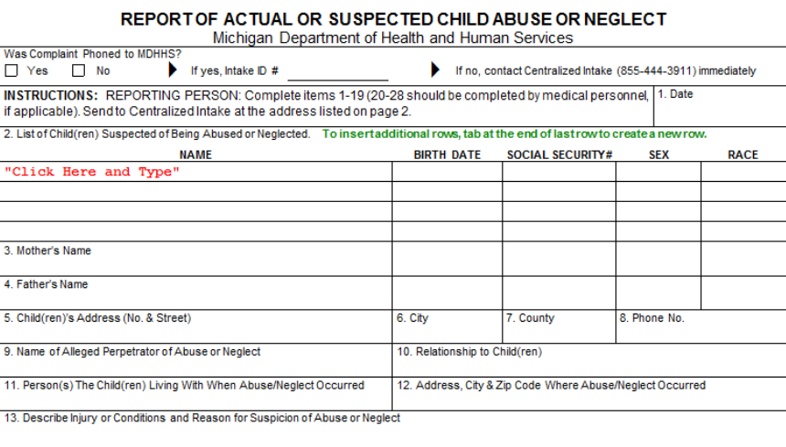
Reporting DHS-3200 Form
Go to http://michigan.gov/dhhs.
Click on “Abuse and Neglect” tab in the middle of screen.
On right side of screen, click on the PDF that corresponds with the DHS 3200.
Notes:
Can hand out to all attendees a copy of DHS 3200 and provide more detail about this process. This form can be used for multiple mandated reporters for a specific incident but should contain all details of the incident observed.
If using the online reporting system, a DHS 3200 is not required as this is a written report. If the hotline is utilized, a DHS-3200 is still required.
DHS-3200 allows for addition of children if using the online version. Hit tab in the child box for the child information and another row will generate.
Allegation section and medical findings section are unlimited.
Can add extra children by hitting tab from the last box in the last row of child information.
Remind audience to input the log/intake number into the form.

Slide 35
Next Steps for CPS
Notification process for mandated reporters includes:
If the report IS investigated, you will receive a letter from the appropriate MDHHS county office following the investigation.
CPS is no longer required to contact the mandated reporter for additional information; however, the investigator may do so if necessary.
Notes:
This letter will tell you only what the case determination is but will NOT include the name of the family or any other identifying information. Use the assigned log number you received when you initially made the first report for follow-up tracking purposes.
A rejection letter is only sent by CI when requested by the mandated reporter.

Slide 36
Next Steps for CPS
Complaint will be reviewed for assignment.
If assigned, a caseworker begins an investigation within 24 hours.
An investigation is normally completed within 30 days.
Services may be offered to the family.
Protecting interventions may be necessary.
CPS will keep your information confidential.
Per the CPL, your identifying information will not be shared unless court ordered.
Notes:
Confidentiality Points
Per CPL, the identity of the reporting person is confidential, subject to disclosure only with the consent of that person or by judicial process. Court ordered sharing is not typical.
The parents may accuse you of reporting.
The parents may say that, “CPS told me you were the one who called in the report.”

Slide 37
Investigating Next Steps for CPS
CPS will interview children, adults, neighbors, family, professional staff, etc.
CPS will coordinate with law enforcement in certain investigations.
Approximately 85% of investigations are not confirmed.
MDHHS will inform mandated reporters in writing as to the result of the investigation.
Notes:
CPS will look for all types of abuse/neglect during an investigation.
CPS will look at prior history and review for trends.
Must meet legal definition of CA/N by a preponderance of evidence (51%).
If a preponderance exists, a Risk Assessment is used to determine risk levels and a Safety Assessment is used to identify safety factors and protecting interventions.
By law, information on the Mandated Reporter is allowable to be shared with law enforcement and the prosecuting attorney.

Slide 38
Outcomes of CPS Investigations
Category V
No services recommended – Following a field investigation, CPS determines there was no evidence of child abuse or neglect.
Category IV
Community services recommended – Though child abuse or neglect was not confirmed, community services are recommended by CPS.
Category III
Community services are needed– A preponderance of evidence supports child abuse or neglect occurred. The risk assessment (structured-decision making tool) indicates low or moderate risk of future harm to the child(ren).
Category II
Services are required to maintain the child safely in the caretaker’s home– A preponderance of evidence supports child abuse or neglect occurred. The risk assessment suggests high or intensive risk of future harm to the child(ren). MDHHS and community services are needed.
Category I
A court petition is filed– A preponderance of evidence supports child abuse or neglect occurred and the law requires a court petition, court ordered services are needed to keep the child(ren) safe in the caretaker’s home, or a child is unsafe in the caretaker’s home.

Slide 39
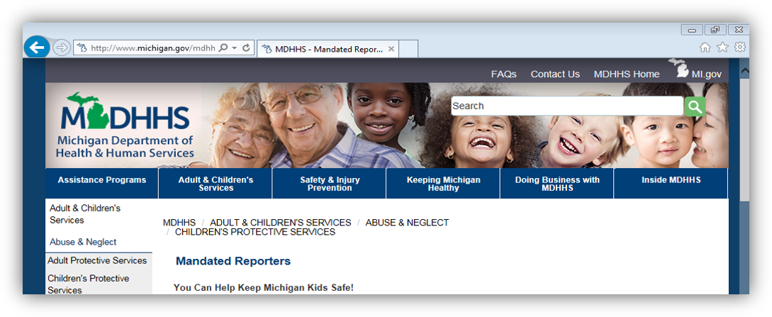
Additional Information
Mandated Reporter resources are available online at:
www.michigan.gov/mandatedreporter
Notes:
Resource on website include: this powerpoint, disproportionality video, guides to recognizing abuse/neglect etc.

