Slide 1
Navigating Airspace Permitting Requirements Airspace 101
Linn Smith
Project Support Unit
Planning and Aviation Services Section
Notes:
Thank you, commissioners. It is always a pleasure to share with you some of the work we do to promote aviation safety. It has been several years since I have presented an update on our airspace permitting requirements, so I appreciate the offer to share this information with you.

Slide 2
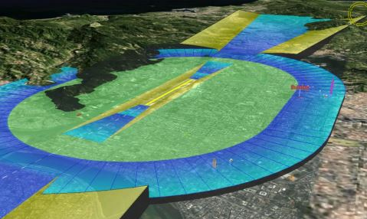
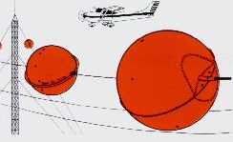
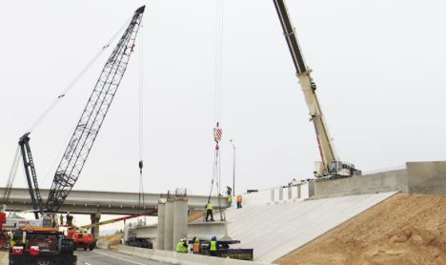
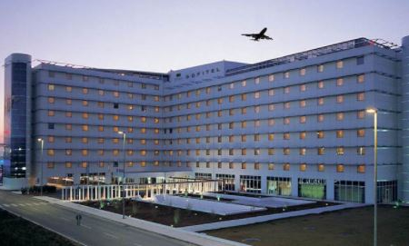
Competing for Airspace
Notes:
From cell phone towers, buildings near airports, power lines, wild turbines or even highway construction projects there is competing interest for the airspace surrounding our public use airports.
Both public and private groups have interest in developing the land and areas around airports, or in close proximity, and heights to flyways.
I want to start with a brief overview of the rules and regulations of various agencies and then discuss the coordination process to get to a final determination to issue or deny a permit.

Slide 3
Multiple Agencies With Oversight Responsibility From Determinations to Actual Permits
FAA
Title XIV of the Code of Federal Regulations (Part 77)
Michigan Tall Structures Act
Act 259 of 1959
Michigan Airport Zoning Act
Act 23 of 1950
Michigan Aeronautics Code
Act 327 of 1945
Michigan Zoning Enabling Act
Act 110 of 2006
Previously included in County/Township/City/Village Zoning Acts effective March 28, 2001
All apply to licensed facilities
Notes:
There are multiple rules, regulations laws that are enforced by multiple agencies that regulate height restrictions and land use controls.
FAA issues a determination that is not enforceable (they only control how pilots fly and airports operate)
Local agencies can control zoning, but height restrictions must be based on a plan approved by the commission (AIRPORT Approach Plan)
Airport Zoning is the only regulation that controls land use
But only one agency can issue a permit and that is the MAC that delegates the authority to the Office of Aeronautics.
Since 1945 Michigan recognized the need to protect people in the air and on the ground in the areas surrounding airports and flyways. Eventually this led to additional protection offered through airport zoning enacted in 1950. Over the next several years a better understanding of safety requirements led to the adoption of the Michigan Tall Structures Act in 1959. Soon after in 1960, the FAA include Part 77 within the code of federal regulations. Over the years the courts helped define the roles of the Federal, State and Local controls. Each has their place and when coordinated, in my opinion, works very well.

Slide 4
FAA Part 77.9 Construction or Alteration Requiring Notice in the Vicinity of a Public Use Airport
45 day advance notice requirement
Emergency situations must file within 5 days
You must notify the FAA if any construction or alteration is:
requested by the FAA
above 200’ AGL
Exceeds an imaginary surface extending outward and upward at the following slopes:
Longest Runway Length | Proximity to Closest Runway | Slope
More than 3200 feet | Within 20,000’ | 100:1
3200 feet or less | Within 10,000’ | 50:1
Heliport | Within 5,000’ | 25:1
Notes:
Lets start with defining what structures and heights need to be filed?
First Anything over 200’ AGL a
Then we move to any structure within 20,000’ of an airport, but only if it exceed a 1:100 imaginary surface from the nearest point on the nearest runway.

Slide 5
Michigan Tall Structure Act
Permit required for:
Structure, or increasing the height of an existing structure, higher than 200’ AGL
Exceeds an imaginary surface extending outward and upward at the following slopes:
Longest Runway Length | Proximity to Closest Runway | Slope
More than 3200 feet | Within 20,000’ | 100:1
3200 feet or less | Within 10,000’ | 50:1
Heliport | Within 5,000’ | 25:1
Notes:
This is very similar to FAA Part 77. The only difference is with temporary structures or a shielded structure

Slide 6
Meteorological Tower Requirements MSTA amended in 2016
MET 50’ AGL or higher not otherwise regulated by law must:
be painted in equal alternating bands of orange and white
have 1 or more 7’ safety sleeves placed at each anchor point
have at least 1 orange marker mall attached to each guy wire at the highest point possible
All MET owner shall provide to the commission:
GPS coordinates
site elevation
AGL height
owner or lessee name, address, phone number and e-mail address
name of owner’s representative
notification of removal of MET within 10 days of removal
Notes:
At the request of the FAA and NTSB, many States including Michigan adopted an amendment to their Tall Structures Act to include MET Towers. This changed the notice criteria and set standards more the marking of these structures that posed potential danger to aerial applicatiors.

Slide 7
Airport Zoning
Do not match FAA Part 77.9 filing criteria
Typically require an airport zoning permit for any structure:
in the approach to a runway regardless of height
anything above 25’
Proponent is responsible for providing us Airport Zoning approval
Required before tall structure permit can be issued
Airport Zoning also includes land use
Notes:
Local ordinance with the ability to grant variances to both height and land use. These plans are based on a MAC approved approach plan so the height restrictions are consistent throughout the State.

Slide 8
Tall Structure Process
FAA Notice Criteria Tool (oeaaa.faa.gov)
File 7460-1 with FAA
If tall structure permit is required, application package created by Aero
FAA issues determination
Applicable Zoning
Airspace Review Team if Necessary
Office of Aeronautics issues Michigan Tall Structure permit
Notes:
The process typically starts with our partners at the FAA, however our office offers assistance to first time users of the on-line filing system. Once the on-line filing is completed, the data sharing agreement with the FAA allows our airspace team to download application information and the State and Local process then runs concurrently saving substantial time. We are at a point now that we can often offer same day service once the FAA has issued their final determination.

Slide 9
OE/AAA Notice Criteria Tool
Notes:
The FAA has a very useful on-line notic criteria tool.

Slide 10
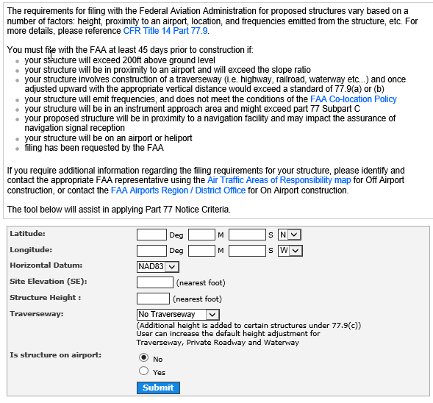
OE/AAA Notice Criteria Tool
Notes:
The tool is simple to use and only requires that you provide coordinate information and elevations.
Unfortunately, the system does have a few issues when analyzing the filing requirements in proximity to airports with instrument approach procedures. If any error occurs, the system will send a notice that “the FAA request that you file”. The FAA is aware of the issue and we offer assistance to applicants when this is encountered, and they bring it to our attention. We ofter run a preliminary analysis with our software program ASM.

Slide 11
Coordination
FAA receives initial filing but MDOT – Aero coordinates
Airspace Requirements for Each Airport
Licensed public use vs Private use
Preliminary Analysis
We receive approximately 5000 applications annually with and additional 750 preliminary analysis to determine if a permit is required. Typically, these preliminary analysis are for MDOT – Highway projects and temporary cranes.
Airport Approach Plans
Airport Zoning
Final Determination
On airport vs of Airport
Notes:
The MDOT Aero staff play such an important role in the process assisting all parties through this process and we try to start that at day one.
As I already discussed, we assist with the application process from the very beginning
We offer to be a Liaison for airport zoning issues
Typically, we are the Liaison for the applicant as they navigate the FAA extended study process
We continual participate in Outreach programs target to assist airport sponsors and concerned citizens with all matters related to airspace protection and airport zoning issues.
Through outreach and education, we promote a better understanding of the requirements early in the development of off airport projects

Slide 12
Tall Structure Process
Typically structures exceeding 200’ above ground require marking and/or lighting
Structure in close proximity to an airport may require marking and/or lighting even below 200’ above ground level
Certain types of studies require special airspace review and extended studies that include a public comment period
FAA and Aero maintain separate databases, with Aero staff assisting FAA with theirs
Notes:
The total Tall Structure process takes approximately 60 days. It can take longer if the FAA issues a Notice of Presumed Hazard, or if the structure penetrates a surface and a public comment period is required as part of an extended studies
Temporary construction equipment typically is processed in a shorter time period as short-term mitigation is much easier to coordinate than permanent restrictions or airspace modifications.

Slide 13
Special Airspace Study
Special airspace study required for a structure that:
is over 500’ AGL within 2 miles of a well-defined natural landmark (shoreline, river); manmade landmark (railroad, canal, road); or low altitude airway
would increase minimum obstruction clearance altitude
would encroach into a primary surface (runway or heliport)
would penetrate approach surface (runway or heliport)
would penetrate transitional surface
would penetrate horizontal surface
would penetrate conical surface

Slide 14
Compliance and Continued Coordination
Request as-built survey information (7460-2)
Review of each colocation request to verify height and lighting requirements along with aeronautical charting (structures over 200’)
Review of Airport Layout Plans and obstacles within 14,000 of the airport
Yearly outreach program to airport managers and sponsors regarding aeronautical notification program
The ability to use drones to quickly and safely verify height and location if necessary
Notes:
Through community outreach, airport manager/sponsor training as well as many partnerships with the FAA and local zoning administrators, compliance is near an all-time high. The use of GPS, GIS software and mapping programs has greatly increased our ability to response more efficiently to request. This directly improves compliance rates.

Slide 15
Tall Structure Contacts
Hilary Hoose
517-335-9418
Kelly Badra
517-335-9282
MDOT_Tall_Structures@Michigan.gov
Airport Zoning Contact
Jennifer Moore
517-335-9418
MooreJ5@Michigan.gov

Slide 16
Questions
Linn Smith
SmithL50@Michigan.gov
517-242-3430

