Slide 1

Educator Evaluation Overview
Office of Educational Assessment
and Accountability

Slide 2
Legislation
Michigan School Reform Law
Districts are required to conduct annual educator evaluations that include student growth as a significant factor.
Notes:
The specific legislative citation is: MCL 380.1249. Those interested can read this summary for more information: http://www.legislature.mi.gov/documents/2009-2010/billanalysis/Senate/pdf/2009-SFA-0926-N.pdf
These were the school reform laws passed in 2009 in support of Michigan’s original Race to the Top application.
There has been movement in the legislature to refine these bills, but in the last session, no changes were made.

Slide 3
Legislation
State Fiscal Stabilization Fund (SFSF)
Districts are required to report the effectiveness label generated by these evaluations.
Notes:
MDE distributed $1.3 billion to school districts through the federal State Fiscal Stabilization Fund (SFSF) to implement and conduct several activities, including educator evaluations. The SFSF grant required districts, as a condition for receiving funds, to sign assurances that included providing reports needed to fulfill the state’s grant application.

Slide 4
What are districts REQUIRED to do?
Michigan School
Reform Law
Conduct annual educator evaluations.
Include measures of student growth as a significant factor.

Slide 5
What are districts REQUIRED to do?
Locally determine the details of the educator evaluations, the consequences, and the timeline for implementation.

Slide 6
What are districts REQUIRED to do?
Tie educator effectiveness labels to decisions regarding promotion and retention of teachers and administrators, including tenure and certification decisions.

Slide 7
What are districts REQUIRED to do?
Use a performance-based compensation method that evaluates performance based, at least in part, on student growth data.

Slide 8
What are districts REQUIRED to do?
  Growth data can include state-provided measures from assessment data AND locally determined measures.
Notes:
State law indicates that districts must use student growth as a significant factor in educator evaluations. However, state law does not specify the use of state-provided growth data only. This means that districts can and should use both the state-provided measures from assessment data as well as locally determined measures of student growth. This can include growth on local assessments, or perhaps more qualitative measures of growth, such as portfolio assessments or other indicators.

Slide 9
What are districts REQUIRED to do?
State Fiscal Stabilization Fund (SFSF)
Report an effectiveness label in the Registry of Educational Personnel (REP) during the end of year submission.

Slide 10
What are districts REQUIRED to do?
  2011: Principals only (based on most recent evaluation)
  2012: All educators (based on annual evaluations)
Notes:
For the 2010-2011 school year, data must be reported on the effectiveness rating of all principals, as required in the SFSF assurances. We understand that you may not have had adequate time to design, bargain and implement a new principal evaluation system for the current school year. Therefore, we are asking that you report the results of the most recent evaluation for all your district principals in the end of year 2011 REP collection.
Senate Bill 1509, which is expected to be signed into law by the Governor, provides an effective date of September 1, 2011 for the new evaluation systems for teachers and administrators. It also clarifies that if a collective bargaining agreement was in effect as of January 4, 2010, and it prevents compliance with the new evaluation requirements, then those requirements do not apply until after the agreement’s expiration. Finally, the bill makes clear that even with the delayed effective date, districts must still submit the data they agreed to submit in their SFSF assurances.
Data on the results of evaluations for ALL EDUCATORS will be collected beginning April 1, 2012 through June 30, 2012.
Who is required to be evaluated?
Educators who administer instructional programs (defined by PA 205): Superintendent, Assistant superintendent/Director of Educational Services, Principal, Assistant Principal
Who is optional? Supervisor/Director of Special Education, School psychologists, counselors, social workers and nurses (unless teaching classes), Speech/language pathologist, Directors (Technical Centers, Early Education), Supervisors (Adult Education, Student Services, Learning Resource Unit, Math/Science Center)
“Optional” means: Encouraged to include in the district evaluation system, Optional to report a label in the REP, Not required to do so by law

Slide 11
What are districts ENCOURAGED to do?
Use the Framework for Educator Evaluations as a model for educator evaluations.
Notes:
This is a collaborative framework developed by the Michigan Education Association (MEA), American Federation of Teachers (AFT), Michigan Association of Secondary School Principals (MASSP) and the Michigan Elementary and Middle Schools Principal Association (MEMSPA). MDE endorses this framework, in support of the collaborative nature in which it was developed.
A copy can be found here: http://mymassp.com/files/A%20Framework%20for%20Michigan%20Teacher%20Evaluations%20%20rev%201-4d.doc
MDE does NOT require that districts use this Framework, but do support that decision if districts choose.

Slide 12
What are districts ENCOURAGED to do?
Identify ways to measure student growth and progress toward proficiency using internal measures and local data.

Slide 13
What are districts ENCOURAGED to do?
Include data from multiple sources as measures of educator effectiveness whenever possible.
Notes:
Educator evaluations are more appropriate and provide a richer source of information to the educators and to other stakeholders if they include multiple measurements of educator effectiveness.

Slide 14
What are districts ENCOURAGED to do?
Collaborate to identify best practices for evaluation methods, metrics in currently non-assessed content areas and grades, and key data sources.
Notes:
MDE will be facilitating some collaborative work (see later in presentation for more detail). However, we encourage districts to work together on their own, and share practices, resources, and ideas. There is an aggressive roll-out timeline for this reform; pooling resources will help facilitate success for districts.

Slide 15
MDE is REQUIRED to:
Link student data with teacher of record beginning in 2010-11 (CEPI/MDE).
  Districts will report “teacher of record” for each course a student takes; local decision.
Notes:
The most important take-away at this point in time is that students are linked to teachers via courses, and that it is a local decision to identify the teacher of record for each course.

Slide 16
MDE is REQUIRED to:
Provide districts and schools with measures of student growth on state-assessments in reading and mathematics for each teacher (regardless of subject taught).

Slide 17
MDE is REQUIRED to:
Provide districts with measures of student proficiency in writing, science and social studies, and reading and mathematics for each teacher (regardless of subject taught)

Slide 18
State-Provided Measures
For each educator, we will generate:
  Student growth
        Reading
        Math
Notes:
Growth data are only available in grades 3-7 in reading and mathematics.
We will generate a report that indicates, for each educator, how many students who were taught by that educator demonstrated growth in math and reading. We will do this regardless of what subject that educator taught. If the student saw that educator for any subject, he/she will be able to see the amount of reading and math growth experienced by each student.
In grades where growth data are not available, no state-provided growth data will be distributed. In these grades and subjects, it is critical that the district identify local measures of student growth that are appropriate for inclusion in the evaluation.

Slide 19
State-Provided Measures
  Percentage of proficient students
  Reading
  Math
  Writing
  Science
  Social Science
Notes:
These data, while not growth data, will be provided for students in all assessed grades, and can be included in the evaluations if the district determines that they should be included.

Slide 20
Growth Data
Achievement “growth” can be calculated only where a Grade 3-8 student has been tested in consecutive years (i.e. reading and Math).
Notes:
We can measure “growth” for students in grades 3-7, which means looking at their scores in grades 4-8. Third grade growth is determined by looking at the change in performance level between third grade (fall test of third grade year) and 4th grade (fall test of 4th grade year). This measure is a measure of how much growth the student had in third grade. Similarly, on the other end of the grade span, the 8th grade test allows for a measure of performance level change due to 7th grade growth.
No growth data is available for pre-3 grades, and for 8th grade. No growth data is available at all in high school, as we only have one test.

Slide 21
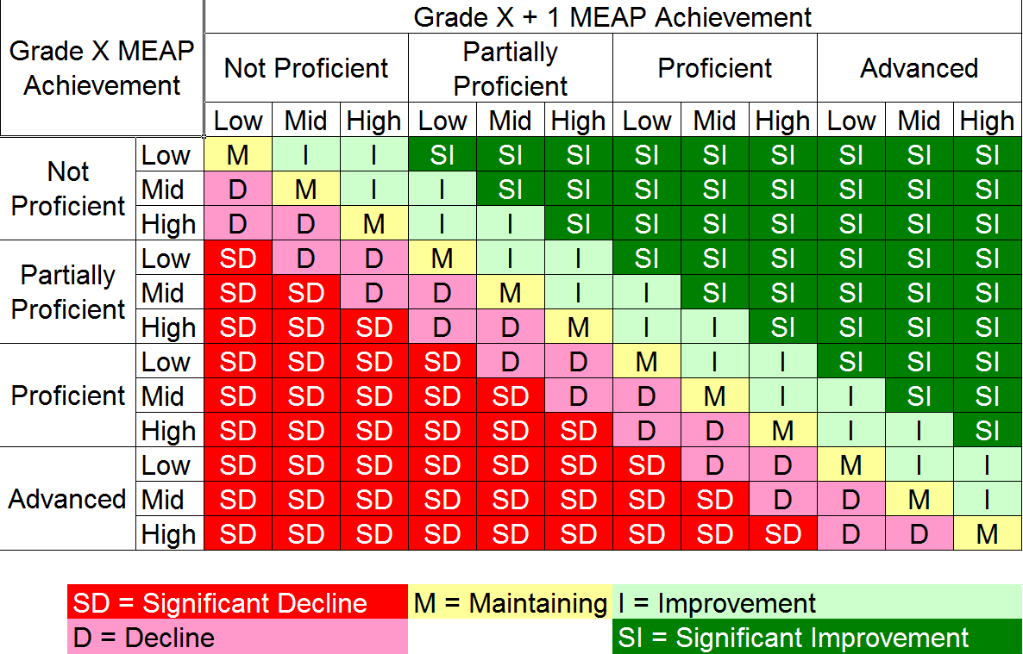
Growth Data
Notes:
We understand that this chart may be difficult to read for those watching via the Web. The Powerpoint will be available for download to allow you to read the graphics.

Slide 22
State-Provided Measures
“Puzzle pieces” approach
Districts choose which “pieces” make sense in their local context.
Reports are generated for each educator, regardless of subject taught or type of position.
Notes:
We will review this in greater detail in future slides. MDE will provide several of the pieces that should be included in educator evaluations, but local districts need to identify and produce the additional pieces necessary to complete the evaluation.

Slide 23
MDE is REQUIRED to:
Report (with CEPI) the proportion of educators rated as highly effective, effective, and ineffective (SFSF/ARRA)

Slide 24
MDE is REQUIRED to:
Report (with CEPI) the factors used in educator evaluations and the proportion of evaluations which include student growth as significant factor.
Notes:
This will be gathered via a survey which will open in conjunction with the 2011 End of Year Registry of Educational Personnel submission. Districts will be asked to indicate the factors used in the evaluations of various types of educators within their district, and to also indicate how student growth data was incorporated.

Slide 25
Statewide Flow of Information: Educator Evaluations
Districts provide information on student courses and teacher of record (Teacher Student Data Link)
Teacher/Student Link
1
2

Slide 26
Statewide Flow of Information: Educator Evaluations
2
Assessment Data
MDE attaches assessment data (proficiency and growth) from each student in each teacher’s courses to that teacher and provides to districts
3

Slide 27
Statewide Flow of Information: Educator Evaluations
Effectiveness Label
3
Districts use assessment data, local measures of growth and other factors to conduct annual evaluations. The results of evaluations are reported back to the state.
4

Slide 28
Statewide Flow of Information: Educator Evaluations
MDE provides aggregate reports to the federal government on the percent of educators in each effectiveness category
4
Federal Reporting

Slide 29
Assessment Data Provided
MDE will provide for each teacher:
  Student growth
        Reading
        Math

Slide 30
Assessment Data Provided
  Percent of students proficient
  Reading
  Math
  Writing
  Science
  Social Science

Slide 31
Draft Data Provided to District for Use in Evaluations

Slide 32
Aggregate Report by Teacher
Notes:
Districts will receive two types of reports. The first is an aggregate report by teacher, where each teacher is listed and the percent of students who were proficient in each subject, and who experienced growth in math and reading, will be provided.

Slide 33
Student Roster for Each Teacher
Notes:
Districts will also receive, for each teacher, a roster of the students who were included in the aggregate calculations. These will be considered preliminary draft data from the state and should NOT be considered final rosters of students for use by anyone except the districts.
This allows districts to work with educators to determine which students are most appropriate to include the evaluations.
Example
Sally Smith teaches science. Her evaluation system specifies that she is held accountable for math and science proficiency levels, and for math and reading growth. However, Sally also teachers a graphics lab one period per day, and 20 of the students on her roster are in that graphics lab. Her evaluation system specifies that she is not held accountable for the math and science scores of those students. Additionally, five students on Sally’s roster were only in her class for three weeks, and received a “withdrawn, failing” grade. Sally and her administrator agree that those students are not a good measure of Sally’s performance, and they are removed from her aggregate calculations.

Slide 34
Final Step: Evaluations
Districts conduct annual evaluations that are:
      locally determined

Slide 35
Effectiveness Labels in REP
Districts determine educators’ local ratings based on evaluations.

Slide 36
Effectiveness Labels in REP
Districts crosswalk local ratings to:
    Framework for Educator Evaluation labels OR
    SFSF Effectiveness Labels

Slide 37
Labels: Framework for Educator Evaluation
Framework for Educator Evaluation suggests four labels:
  Exceeds Goals
  Meets Goals
  Progressing Toward Goals
  Does Not Meet Goals
Notes:
MDE and CEPI have built the REP reporting of this field to allow districts to utilize the Framework for Educator Evaluation labels if they choose. This recognizes MDE’s endorsement of this collaborative framework.

Slide 38
Framework Labels | SFSF Labels
Exceeds goals | Highly effective
Meets goals OR Progressing toward goals | Effective
Does not meet goals | Ineffective

Slide 39
MDE Support for Evaluations
Guidance and evaluation “toolbox”
Inventory of current practices
Collaboration with external stakeholders
Notes:
--Toolbox will include suggested models and methods for including student growth data in your evaluation process.
--Inventory of current practices around educator evaluations and share findings with stakeholders
--Collaborate with external stakeholders who are developing models of evaluation systems, collective bargaining agreements, and best practices—assist in making findings available to districts and schools.

Slide 40
MDE Support for Evaluations
Referent groups focused on:
Evaluating non-assessed grades/ content areas.
Use in “value-added models.”
Notes:
--Convene referent groups to identify suggested metrics and methods for evaluating educators in non-assessed grades/content areas. Establish methodological referent groups to discuss the use of state assessment data in “value-added models.”

Slide 41
Timeline
End of year 2011:
  Teacher Student Data Link Collection available in MSDS.

Slide 42
Timeline
End of year 2011 (continued):
  Principal effectiveness ratings must be reported in REP.
  Other administrators encouraged, but optional until 2012.

Slide 43
Timeline
Early fall 2011:
MDE will provide districts with measures for all educators based on data from the 2009-10 & 2010-11 school years.

Slide 44
Timeline
Fall 2011 – Spring 2012:
Districts conduct educator evaluations as locally bargained/determined.

Slide 45
Timeline
End of year 2012:
Districts report effectiveness ratings for all administrators and teachers.

Slide 46
Contact Information
Carla Howe Olivares
Evaluation Research & Accountability
Office of Educational Assessment & Accountability
MDE-Accountability@michigan.gov
877-560-8378, choose option 6

