Slide 1
Built by Bonds
Issuing Bonds with
Bureau of State & Authority Finance

Slide 2
“Size” the Deal
Define the project needs
Find out how much money the borrower needs

Slide 3
State and Authority Finance
The Bonding Process
How does the Bureau accomplish its mission

Slide 4
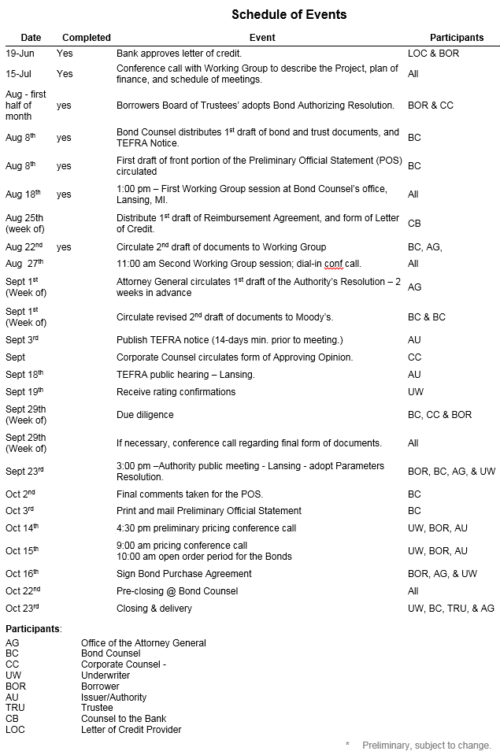
Timing is Everything
Find out when the borrower needs the money
Work with team members to develop a schedule to ensure the borrower receives the money when needed

Slide 5
Select the Team
Underwriters: sell/place the bonds with investors
Bond counsel: provides legal advice as well as opinions on the legality and taxability of bonds
Trustee: manages the flow of funds
Financial Advisor: independent third party that advises the borrower regarding the terms and structure of the deal

Slide 6
Finance Team Members
Issuer
Issuer’s Counsel
Financial Advisor
Bond Counsel
Underwriter
Underwriter’s Counsel
Trustee
Rating Agencies
Credit Enhancement Providers

Slide 7
“Structure” the Deal
Determine the maturity of the bonds - When the investor is repaid the principal on their investment
Determine the security for the bonds - The strength of the security will affect the interest rate on the bonds
Ascertain the most cost effective interest rate mode, income tax status, and terms of re-payment

Slide 8
Debt Instruments
BONDS (Long-Term Financing)
A bond is written evidence of a borrower’s obligation to pay principal and interest at specified times and dates on money borrowed
NOTES (Short-Term Financing)
A note is essentially the same as a bond except that the debt must be repaid within one year

Slide 9
Types of Bonds
Municipal Bonds (when issued for a public purpose project) are exempt from federal and state income taxes.
General Obligation (G.O.) Bonds are secured by the “full faith and credit” of the issuer. The holders of a G.O. bond have the right to establish a tax levy or appropriation in order to satisfy the issuer’s obligation.
Revenue Bonds are payable from specific sources of revenues, other than property taxes, and are not backed by the “full faith and credit” of the issuer.

Slide 10
Forms of Municipal Bonds
Serial Bonds - Repayment of principal on an annual basis
Term Bonds - Single repayment (maturity) of principal
Capital Appreciation Bonds (CABs) - Bonds that pay no interest prior to their maturity. The difference between the purchase price and the final maturity value represents the interest earned on the bond
Variable Rate Demand Bonds (VDRO’s) - Bonds issued with a variable interest rate. Investors have the right to ‘put’ the bonds back to the issuer. VDRO’s require liquidity in the form of a letter of credit.

Slide 11
Types of Notes
Bond Anticipation Notes (BANs) are issued to obtain interim financing for projects that will eventually be financed through the sale of long-term Bonds.
Tax and Revenue Anticipation Notes (TANs) are issued in anticipation of tax receipts or other revenues.
Tax-Exempt Commercial Paper (TECP) is a flexible form of short-term financing that is used to smooth cash flow inefficiencies and has a maximum maturity of 270 days.

Slide 12
More Considerations
Assist the borrower in considering the purchase of additional security
Rating - Obtain a credit rating from an independent third party to verify the credit worthiness of the borrower
Insurance - Guaranteed payment of the bonds from a third party
Letter of Credit - Guaranteed payment from a bank

Slide 13
Credit Structure
Credit Ratings
A credit rating agency evaluates the “credit worthiness” of the borrower and the ability of the borrower to repay the debt.
Three independent companies publish credit ratings upon request for both corporate and municipal debt. They are:
Moody’s Investors Service
Standard and Poor’s (S&P)
Fitch Ratings

Slide 14
Short-Term Credit Ratings
Category | S & P | Moody’s | Fitch
Very Strong | S&P-1 | MIG-1 | F-1
Satisfactory | S&P-2 | MIG-2 | F-2
Satisfactory but susceptible |  | MIG-3 | F-3
Speculative | S&P-3 | MIG-4 | F-4

Slide 15
Long-Term Credit Ratings
Category | S & P/Fitch | Moody’s
Highest | AAA | Aaa
Very Strong | AA+ / AA / AA- | Aa1 / Aa2 / Aa3
Strong but susceptible | A+ / A / A- | A1 / A2 / A3
Vulnerable - “Junk” Status | BB+ / BB / BB- B+ / B / B- CCC+ / CCC / CCC- | Ba1 / Ba2 / Ba3 B1/ B2 / B3 Caa1 / Caa2 / Caa3
Lowest Grades | CC / C / D | Ca / C

Slide 16
Draft the Documents
Board Resolutions
Official Statement
The Bonds or Notes
Internal Revenue Service Documents

Slide 17
Sell the Deal
Distribute offering document (Official Statement)
Underwriters market to banks, funds, and individuals
State (Authority) signs the purchase agreement

Slide 18
Sale of the Bonds
Competitive vs. Negotiated Sale
Competitive Sale: the issuer sets a date for the sale and accepts sealed bids from potential buyers. At a specified date/time the issuer opens the bids and awards the bond sale to the lowest interest cost bidder.
Negotiated Sale: the issuer selects an underwriter who then structures and sells the bond issue.

Slide 19
Who Buys Municipal Bonds
Mutual Funds
Insurance Companies
Commercial Banks
Individual Investors commonly called “retail” investors

Slide 20
Holders of Municipal Debt

Slide 21

Close the Deal
Sign bond purchase agreement
Obtain legal opinions
Finalize offering document

Slide 22
Show Me The Money
Once the documents have been signed and the deal has been closed, the funds (money) is sent via wire transfer
Release bonds to the investors

